Slide 1
Copyright and the
Public Domain
Justin Bonfiglio
February 2020
This presentation was prepared by Justin Bonfiglio in February 2020.
Some slides were drawn from CC-BY 4.0 licensed slides created by Ana Enriquez.

Slide 2
Contact info
copyright@umich.edu
www.lib.umich.edu/copyright/
Notes:
Feel free to e-mail us with your questions.

Slide 3
The plan
UM Library Copyright Office
Copyright – Brief intro
Public Domain in the United States
Questions
Feel free to ask questions at any time.

Slide 4
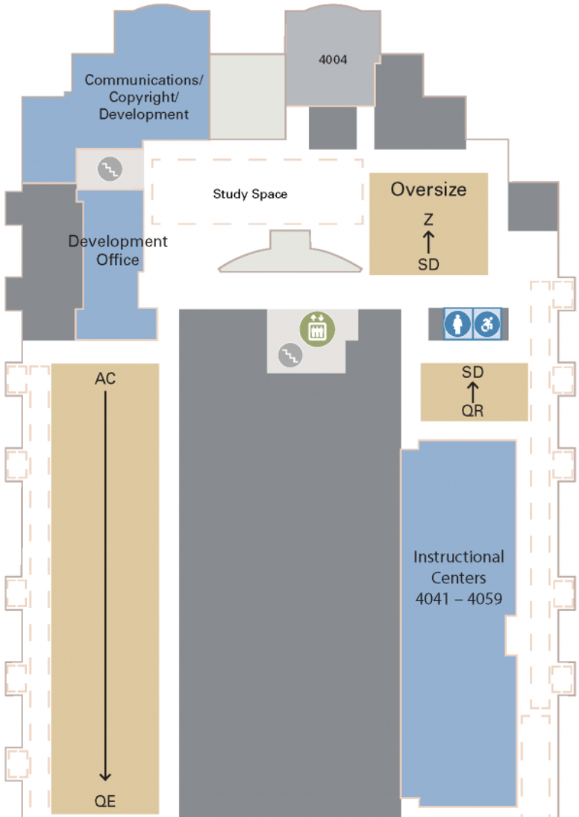
Office info
UM Library Copyright Office
Shapiro Library, fourth floor
919 South University
Ann Arbor, MI 48109
copyright@umich.edu
Website:
http://www.lib.umich.edu/copyright-office
Melissa Levine
Director, Copyright Office
mslevine@umich.edu
Yuanxiao Xu
Copyright Specialist
xuyu@umich.edu
Raven Lanier
Copyright Specialist
rnlanier@umich.edu
Justin Bonfiglio
Copyright Specialist
jbonfig@umich.edu

Slide 5
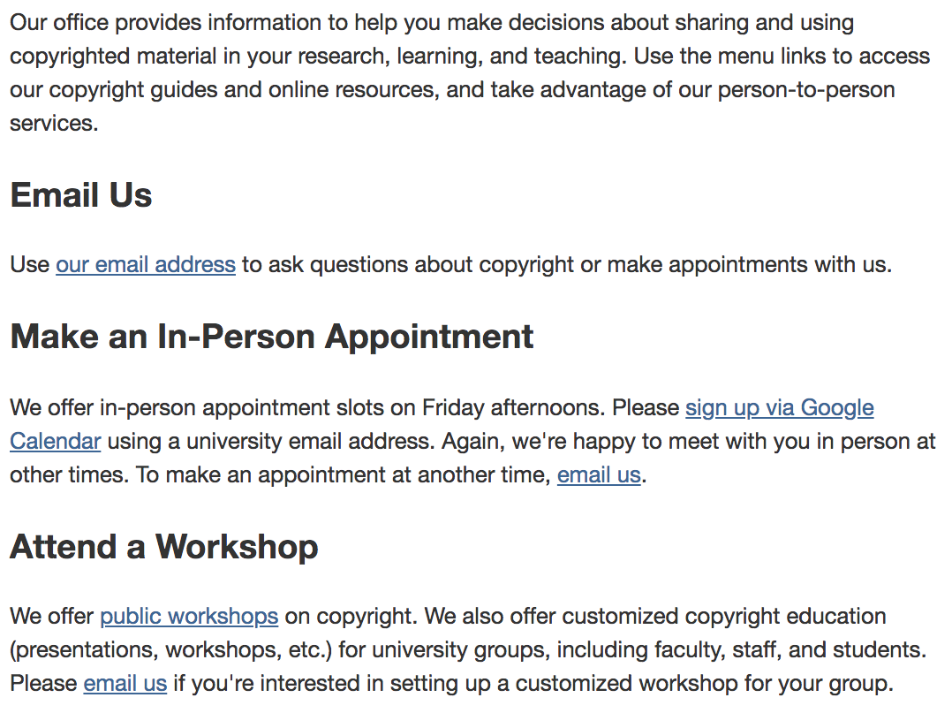
UM Library Copyright Office: Contact Us

Slide 6
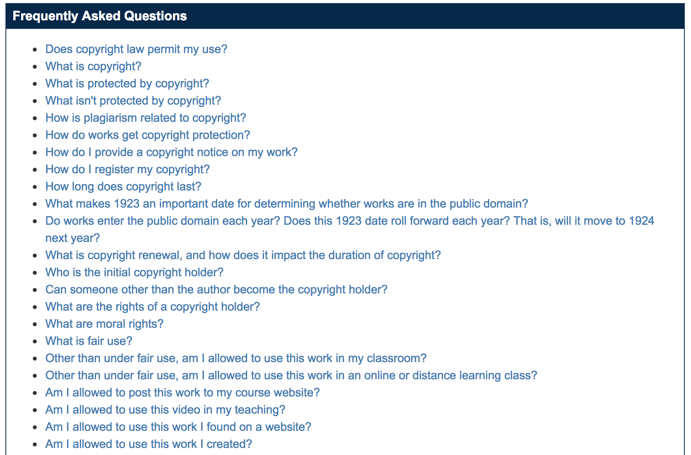
UM Library Copyright Office Resources: Website
Notes:
Source: https://guides.lib.umich.edu/copyrightbasics/faq

Slide 7
Framework of copyright considerations
Is the work protected by copyright?
Who holds the copyright? Have they made any licenses that would permit your use?
Do any user’s rights, such as fair use, apply?
Will you seek permission?
Resource: Copyright Basics guide
Notes:
These are important questions for any copyright-related use decision that you might make.

Slide 8
Public Domain in the United States
In the United States, a copyrightable work is in the public domain if:
  It is a work of the United States Government (17 U.S.C. § 105).
  Its copyright holder placed it in the public domain using the Creative Commons Public Domain Dedication.
  It was published before March 1, 1989 and did not comply with one or more of the required formalities (e.g., copyright notice, renewal).
    Note: if the work was first published outside of the United States, copyright restoration may apply.)
  The term of its copyright protection has ended.
Every country has its own rules about when a copyrightable work enters the public domain.
To determine a work’s US public domain status, here are some good starting points:
  Cornell's chart, Copyright Term and the Public Domain in the United States
  Berkeley's handbook, Is it in the Public Domain?

Slide 9
17 U.S. Code § 105. Subject matter of copyright: United States Government works
“Copyright protection under this title is not available for any work of the United States Government…” (§ 105)
“A “work of the United States Government” is a work prepared by an officer or employee of the United States Government as part of that person’s official duties.” (§ 101)

Slide 10
Removed NASA image due to large file size
https://images.nasa.gov/details-a-sky-view-of-earth-from-suomi-npp_16611703184_o.html

Slide 11
Public domain dedications
Until 1 March 1989: Publish without notice and don’t register.
Today: Use the Creative Commons Public Domain Dedication.
  Creative Commons has developed a tool to help rights holders dedicate their works to the public domain.
  Not absolutely necessary that you use the Creative Commons Public Domain Dedication (CC0), but it is a helpful and user friendly tool.

Slide 12
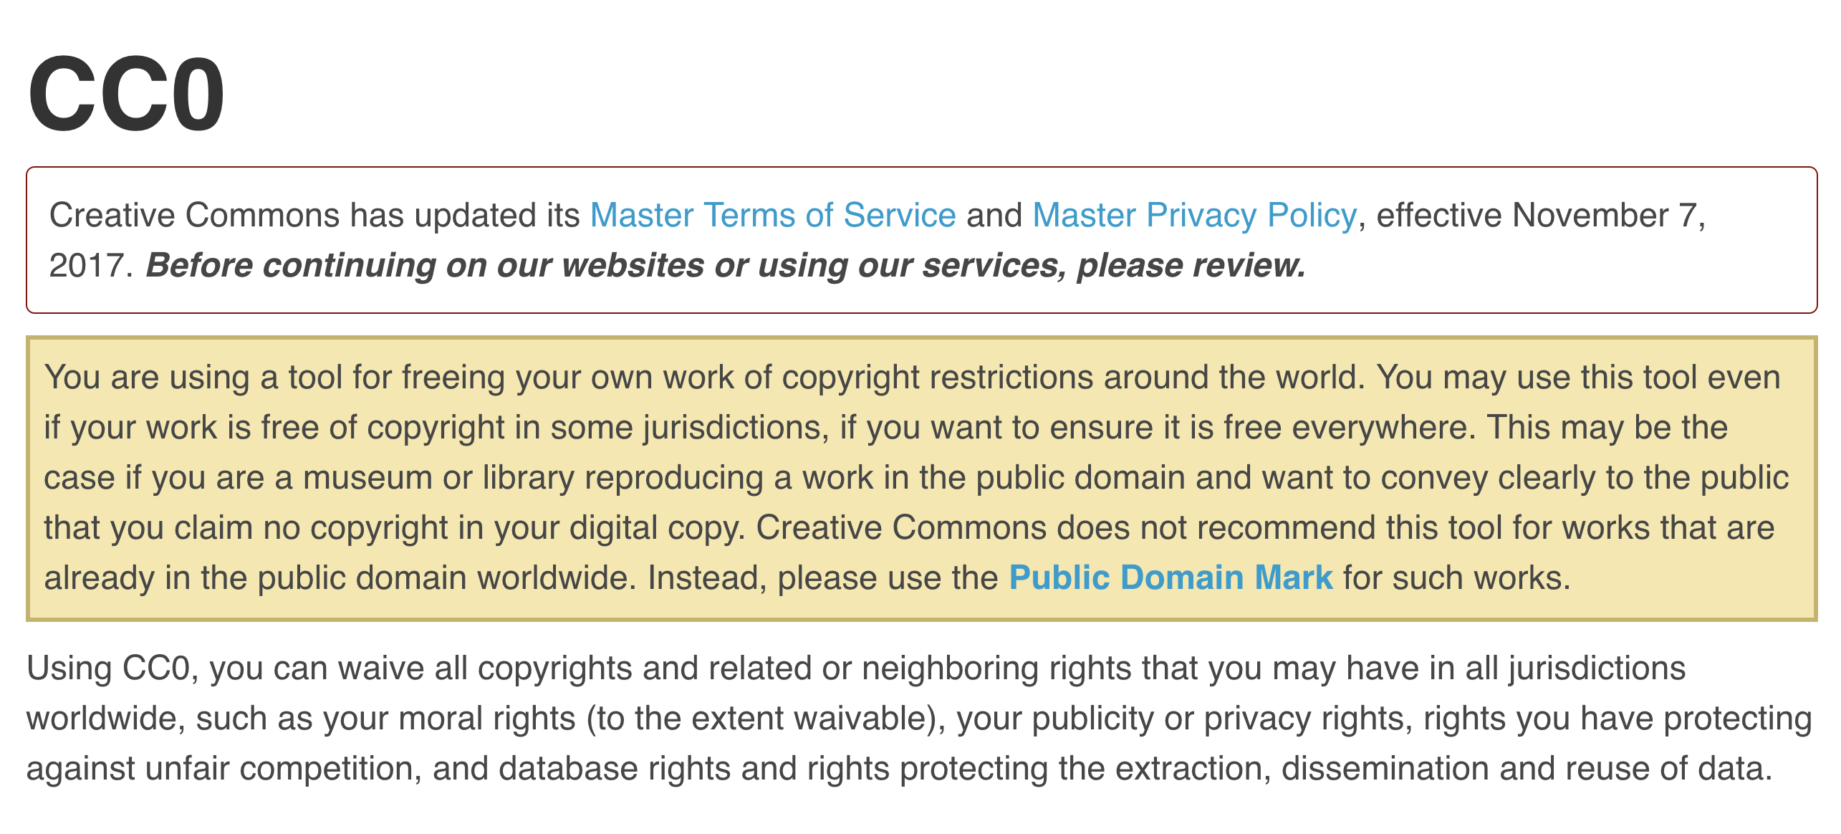
Public Domain Dedication Tool
https://creativecommons.org/choose/zero/

Slide 13
Copyright notice requirement
Notice Example: © 2017 John Doe
From 1923 to 1977, publication without notice caused forfeiture of copyright in the United States.
From 1978 to March 1, 1989, publication without notice and without subsequent registration within five years caused forfeiture of copyright in the United States.
No notice requirement after March 1, 1989.

Slide 14
Renewal
The renewal requirement applied to works published in the U.S. from 1925 to 1963.
For a work in that time range, non-renewal put the work in the public domain in the United States.
Renewal records for works published in that time range can be found in the US Copyright Office’s Catalog of Copyright Entries and its online catalog.

Slide 15
1909 Act
Illustration from CopyrightX Lecture 6: The Mechanics of Copyright, by William Fisher, licensed under the CC-BY 4.0 International License.

Slide 16
Expiration: Copyright term based on publication date
Works published 1925 – 1963 (inclusive), published with notice and copyright was renewed.
For these works, copyright expires 95 years after publication.
On January 1, 2019, works published in the United States in 1923 entered the public domain in the United States.
On January 1, 2020, works published in the United States in 1924 entered the public domain.

Slide 17
Expiration: Copyright term based on author death date
Works created under the current copyright regime will enter the public domain on January 1 following the 70th anniversary of the author’s death.
For instance, if the author of a work created today died on July 15, 2046, that work would enter the public domain on January 1, 2117.

Slide 18
Restoration
Criteria for copyright restoration under URAA:
At the time the work was created, at least one author (or rightholder in the case of a sound recording) must have been a national or domiciliary of an eligible source country.
The work is not in the public domain in the eligible source country through expiration of the term of protection.
The work is in the public domain in the United States because it did not comply with formalities imposed at any time by U.S. law, lacked subject matter protection in the United States in the case of sound recordings fixed before February 15, 1972, or lacked national eligibility in the United States.
If published, the work must have been first published in an eligible country and not published in the United States during the 30-day period following its first publication in the eligible country.

Slide 19
Questions?

Slide 20
Contact info
copyright@umich.edu
www.lib.umich.edu/copyright/

Slide 21
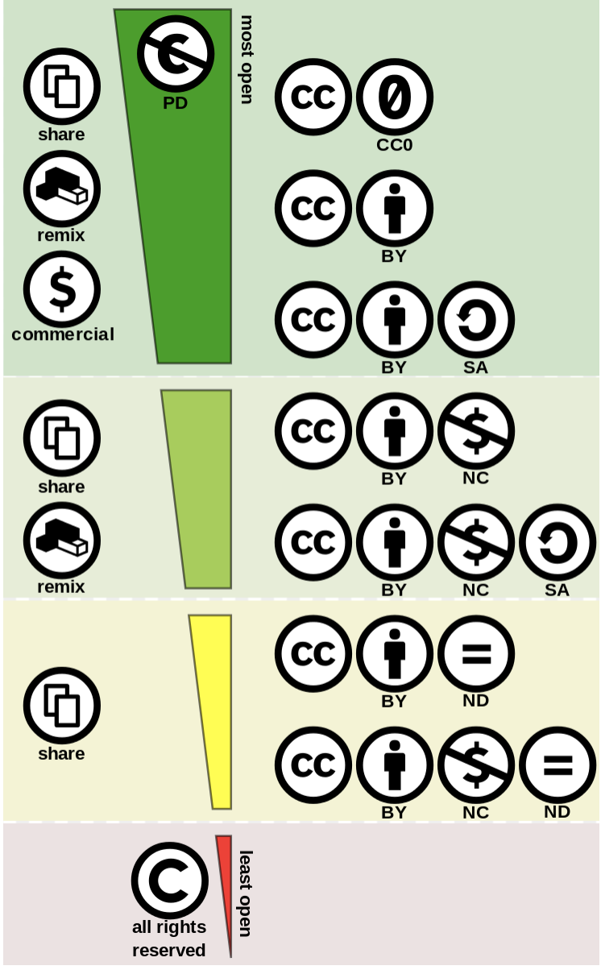
This work “Creative Commons license spectrum” was authored by Shaddim, and was found on Wikimedia Commons. It is licensed under a CC BY 4.0 International license. (Shaddim: Original CC license symbols licensed by Creative Commons under a CC BY 4.0 license.)
Notes:
For more information about Creative Commons licenses, consider starting here: https://guides.lib.umich.edu/creativecommons

Slide 22
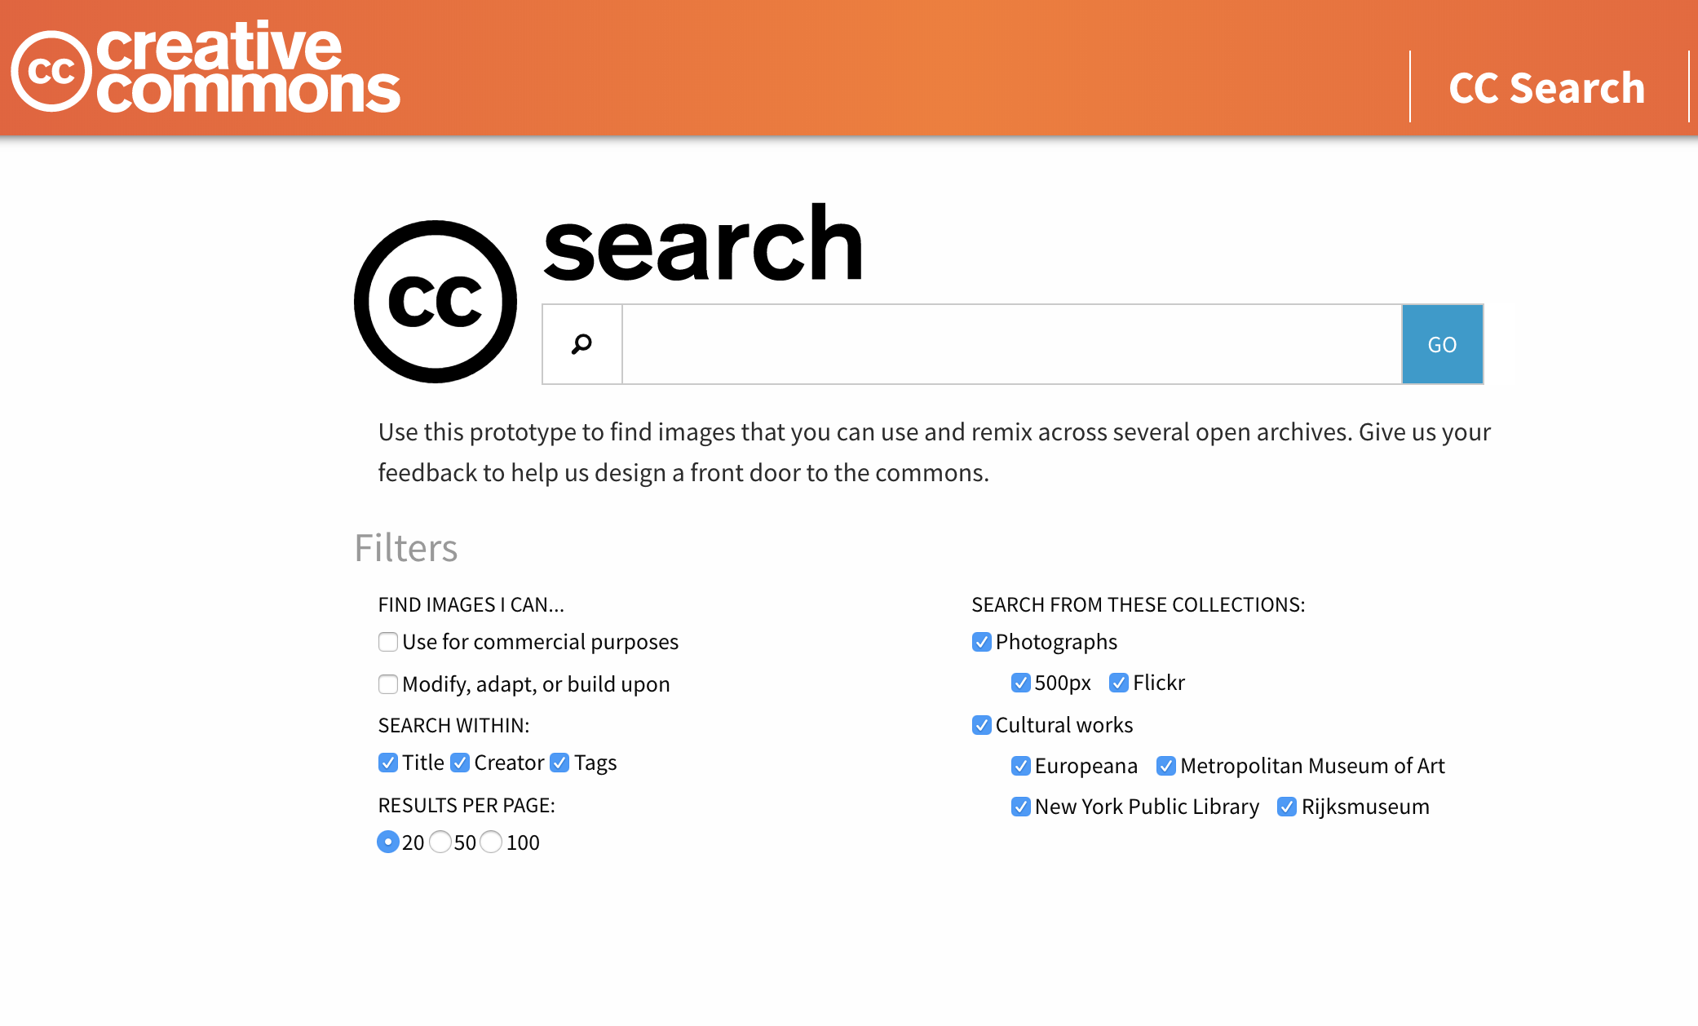
https://ccsearch.creativecommons.org/
https://search.creativecommons.org/

Slide 23
Do any user’s rights, such as fair use, apply?
“. . . the factors to be considered shall include—
the purpose and character of the use, including whether such use is of a commercial nature or is for nonprofit educational purposes;
the nature of the copyrighted work;
the amount and substantiality of the portion used in relation to the copyrighted work as a whole; and
the effect of the use upon the potential market for or value of the copyrighted work.”
To assess fair use, we recommend:
  Columbia’s Fair Use Checklist
  Stanford’s Summaries of Fair Use Cases
  US Copyright Office Fair Use Index
  Fair Use for Nonfiction authors
Notes:
These are particularly useful fair use resources and this slide also includes the four fair use factors from the Copyright Act.

Slide 24
Excerpt from Cornell University’s Checklist For Conducting a Fair Use Analysis Before Using Copyrighted Materials
copyright.cornell.edu/policies/docs/Fair_Use_Checklist.pdf
Notes:
Very helpful fair use checklist available via the link above.

Slide 25
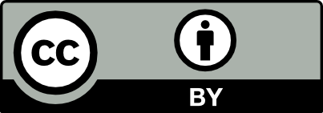
Campbell v. Acuff-Rose
“The central purpose of [the first factor] is to see, in Justice Story’s words, whether the new work merely ‘supersede[s] the objects’ of the original creation, or instead adds something new, with a further purpose or different character, altering the first with new expression, meaning, or message; it asks, in other words, whether and to what extent the new work is ‘transformative.’”
Campbell v. Acuff-Rose Music, 510 U.S. 569 (1994) (citations omitted).
This slide was prepared by Ana Enriquez in February 2016 and revised in February 2017. It is licensed under the Creative Commons CC-BY 4.0 International License.

Slide 26
Resources to help with US public domain determinations.
The work itself (copyright notice review)
Copyright Term and the Public Domain in the United States
This chart from Cornell guides users through the process of determining a work's US public domain status.
Is it in the Public Domain?
This handbook from Berkeley guides users through the process of determining a work's public domain status. It focuses on works created in the U.S. between January 1, 1923 and December 31, 1977.
Stanford Copyright Renewal Database
Catalog of Copyright Entries
    USCO Circular 38b Copyright Restoration under the URAA

Slide 27
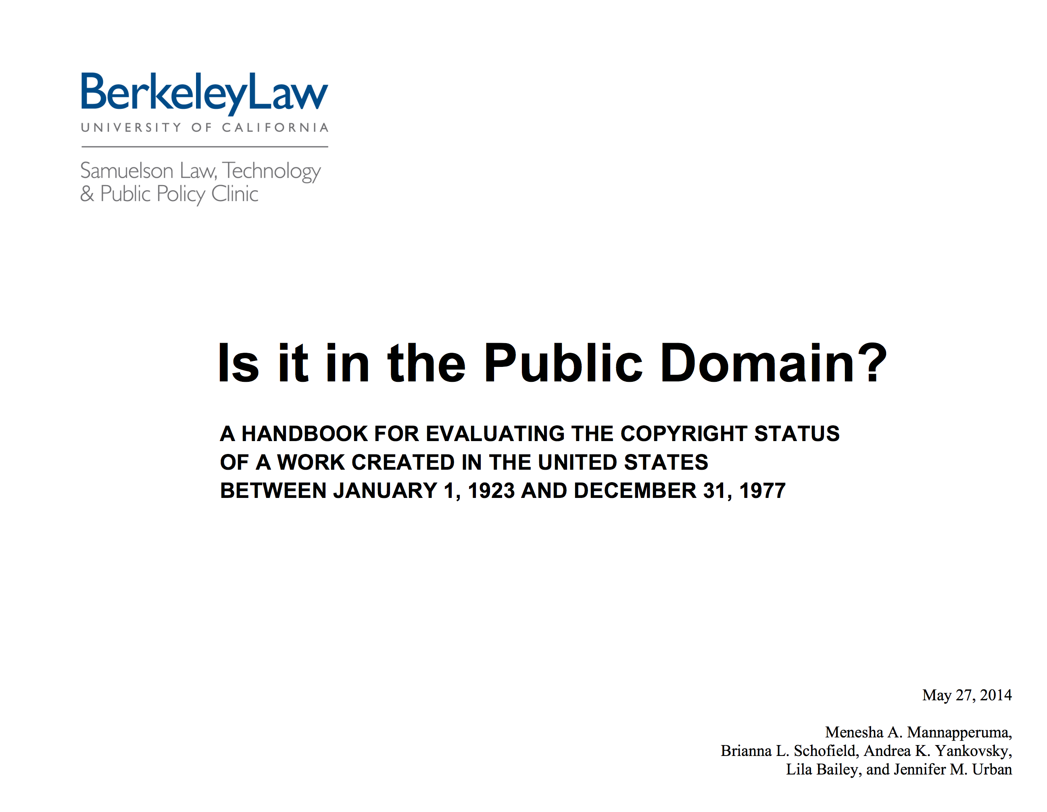
Resources
https://www.law.berkeley.edu/files/FINAL_PublicDomain_Handbook_FINAL(1).pdf

Slide 28
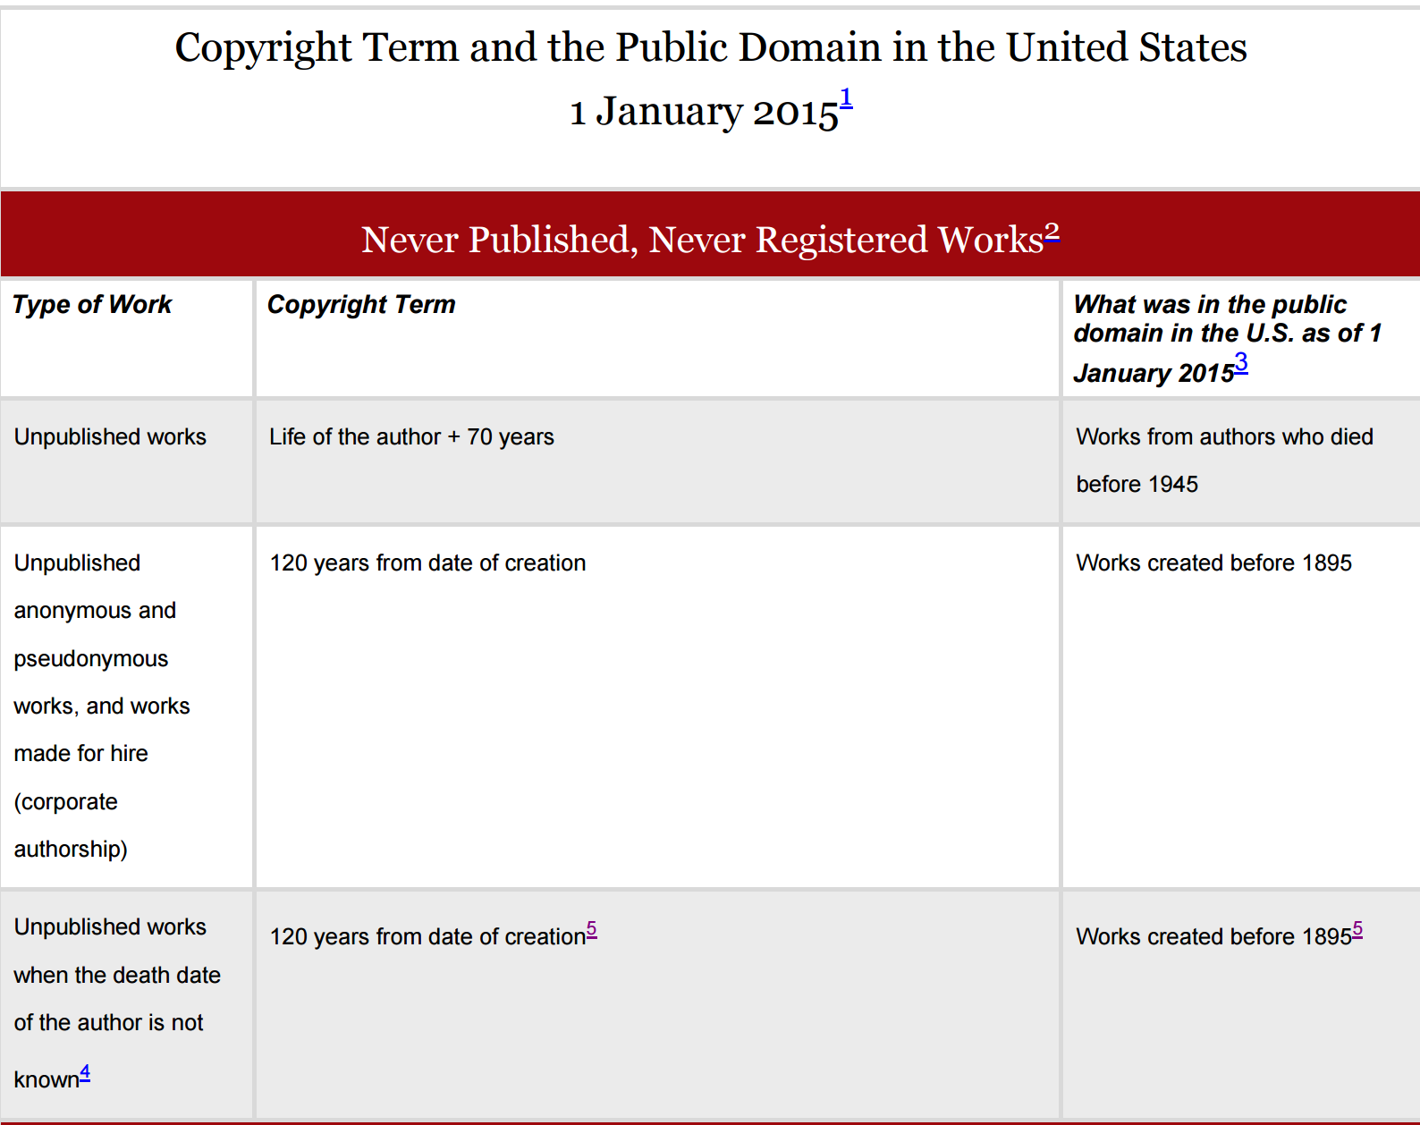
Resources
http://copyright.cornell.edu/resources/publicdomain.cfm

Slide 29
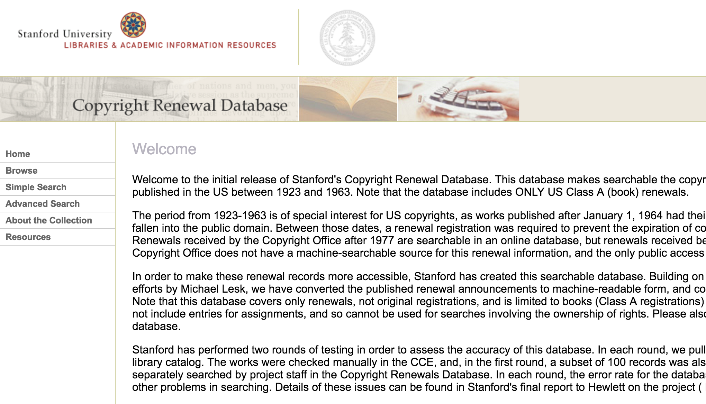
Resources
https://collections.stanford.edu/copyrightrenewals/bin/page?forward=home

Slide 30
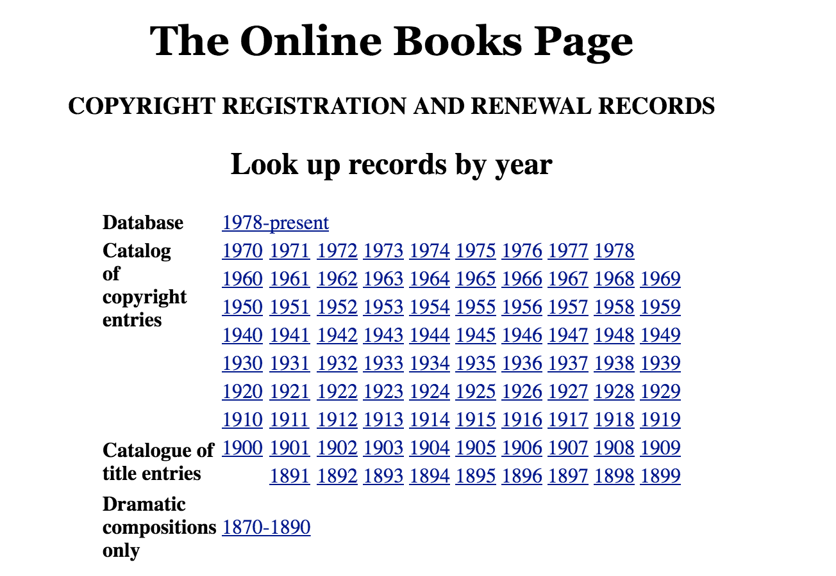
Resources
http://onlinebooks.library.upenn.edu/cce/

Slide 31
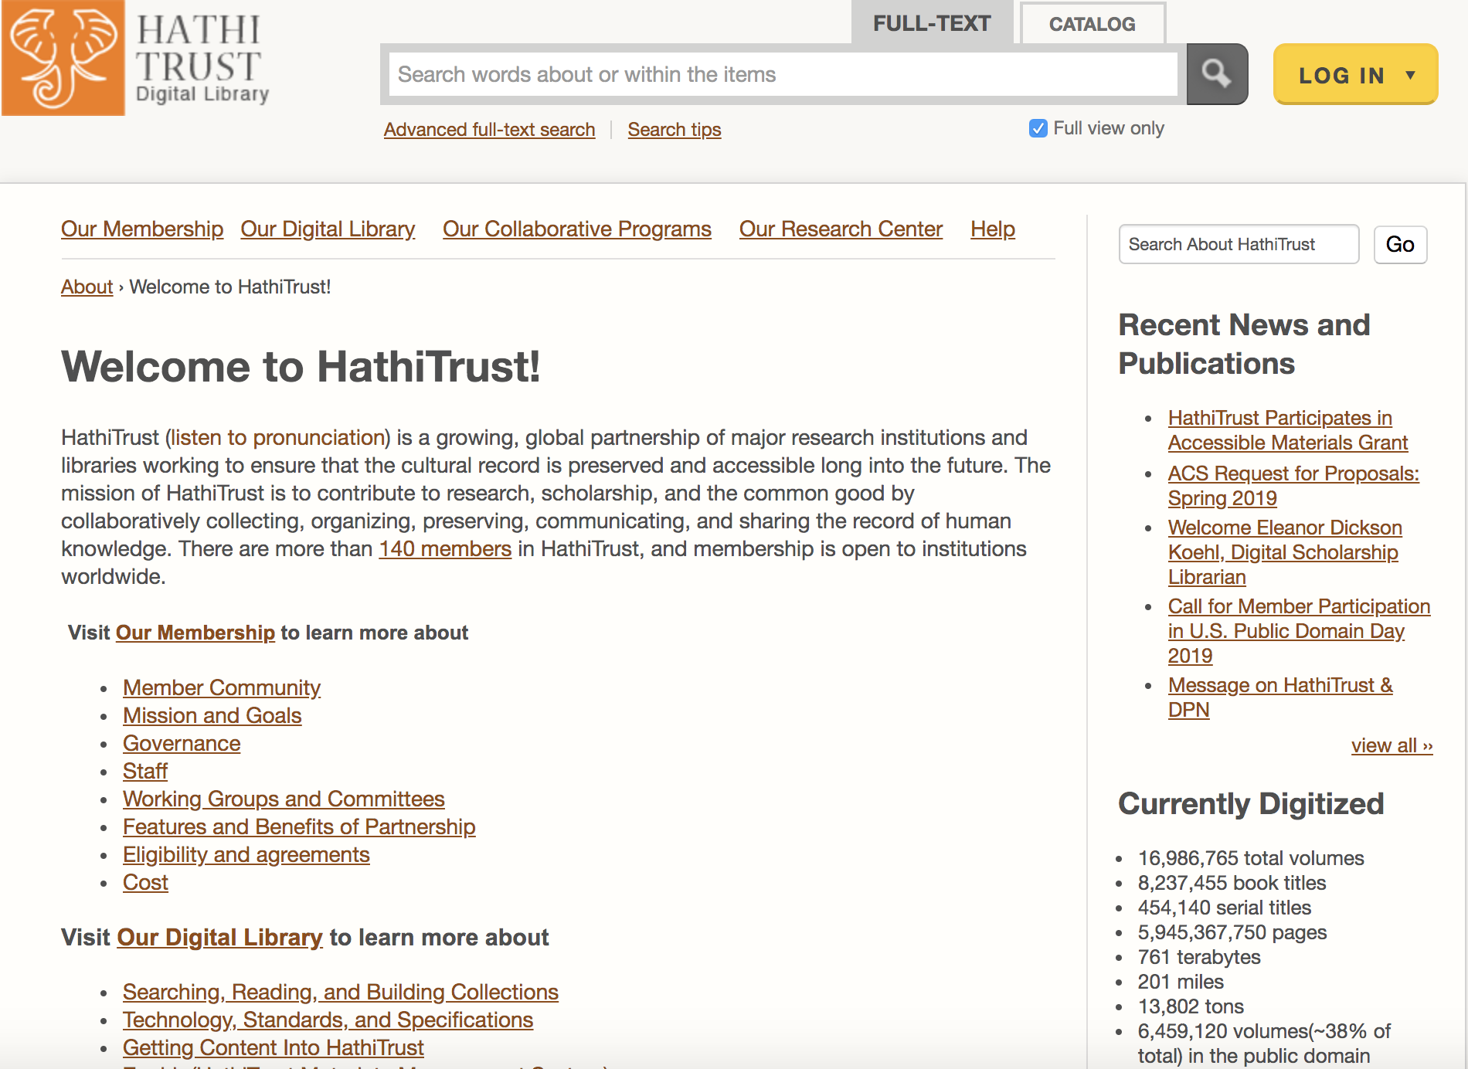
https://www.hathitrust.org/about

Slide 32
Questions?

