Slide 1
Intro to Copyright

Slide 2
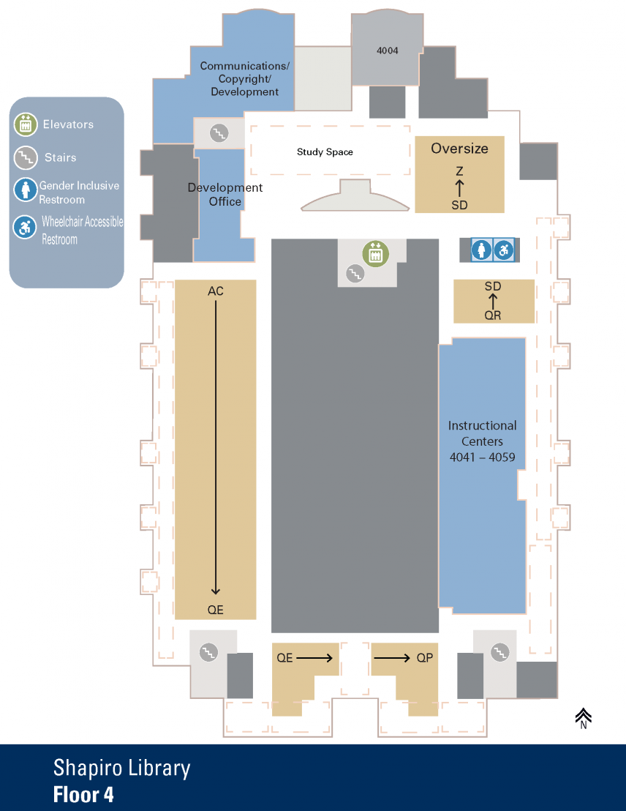
U-M Library Copyright Office
Shapiro Library, fourth floor
Website: www.lib.umich.edu/copyright-office
Workshops:
umlib.us/copyright2018
Yuanxiao Xu
Copyright Specialist
xuyu@umich.edu

Slide 3
Email us (copyright@umich.edu) to...
Ask questions about copyright
Make appointments
Set up customized workshop
Collaborate in other ways

Slide 4
Overview
What is copyright
Scope of copyright
How to use copyrighted works

Slide 5
Opinion Poll
Should this be under copyright?
Shakespeare’s play
President Trump’s diary
The workshop I’m about to deliver today

Slide 6
Opinion Poll
How long should it be under copyright?
28 years
56 years
75 years
95 years

Slide 7
Rights of Copyright Holder
• Reproduce the work in copies or phonorecords
• Prepare derivative works based upon the work
• Distribute copies or phonorecords of the work to the public by sale or other transfer of ownership or by rental, lease, or lending
• Perform the work publicly if it is a literary, musical, dramatic, or choreographic work; a pantomime; or a motion picture or other audiovisual work
• Display the work publicly if it is a literary, musical, dramatic, or choreographic work; a pantomime; or a pictorial, graphic, or sculptural work. This right also applies to the individual images of a motion picture or other audiovisual work.
• Perform the work publicly by means of a digital audio transmission if the work is a sound recording
Copyright also provides the owner of copyright the right to authorize others to exercise these exclusive rights, subject to certain statutory limitations.
Notes:
Under the 1976 Copyright Act, the copyright owner has the exclusive right to reproduce, adapt, distribute, publicly perform, and publicly display the work. In the case of sound recordings, the copyright owner has the right to perform the work publicly by means of a digital audio transmission. These exclusive rights are freely transferable, and may be licensed, sold, donated to charity, or bequeathed to your heirs. It is illegal for anyone to violate any of the exclusive rights of the copyright owner.

Slide 8
Infringement of Copyright
You literally copy from the original
AND
Your copy is “substantially similar” to the original

Slide 9
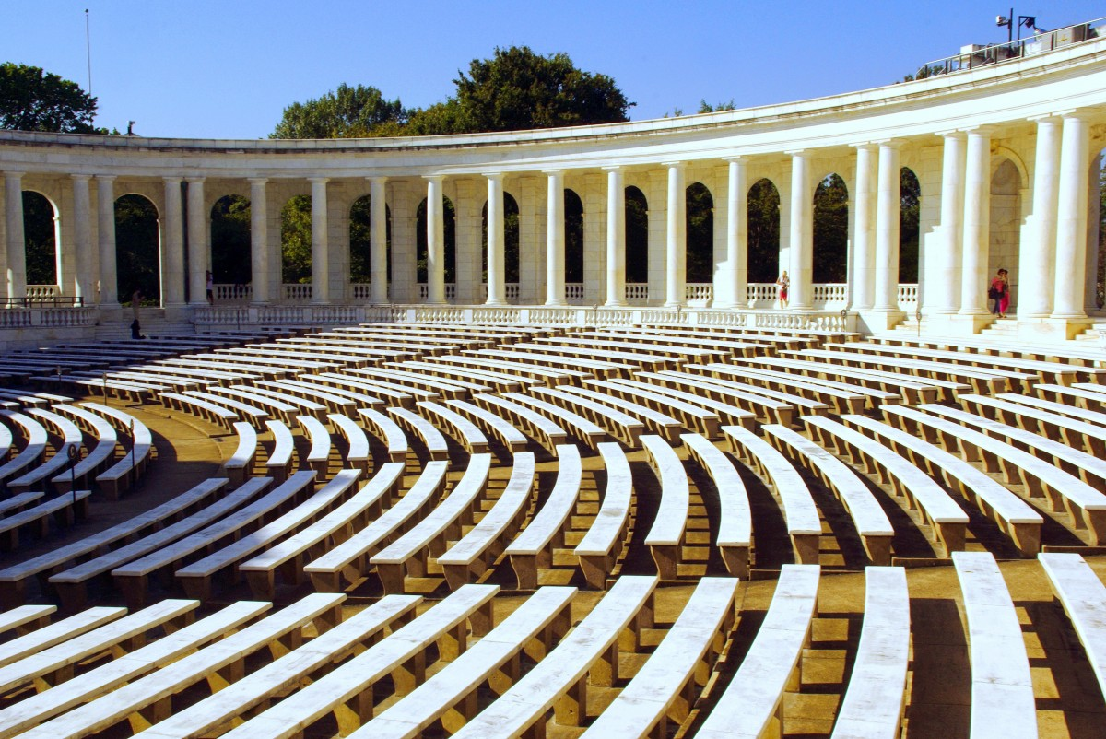

Slide 10
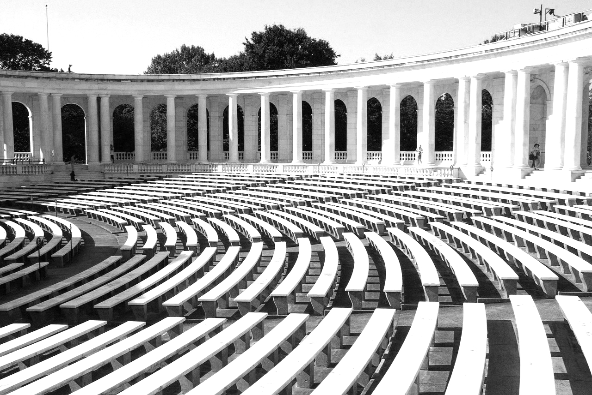

Slide 12
Why Copyright?
The U.S. Constitution gives Congress the ability
"...to promote the Progress of Science and useful Arts, by securing for a limited Time to Authors and Inventors the exclusive Right to their respective Writings and Discoveries."

Slide 13
Subject Matter of Copyright
• Literary works
• Musical works, including any accompanying words
• Dramatic works, including any accompanying music
• Pantomimes and choreographic works
• Pictorial, graphic, and sculptural works
• Motion pictures and other audiovisual works
• Sound recordings, which are works that result from the
fixation of a series of musical, spoken, or other sounds
• Architectural works

Slide 14
Subject Matter of Copyright
“Copyright protection subsists, in accordance with this title, in original works of authorship fixed in any tangible medium of expression, now known or later developed”
17 U.S. Code § 102

Slide 15
Subject Matter of Copyright
Original
Modicum of creativity
Independent creation
Fixed
Notes:
Originality requires only that the author make the selection or arrangement independently … and that it display some minimal level of creativity.
The manner and medium of fixation are virtually unlimited.

Slide 16
How to Secure Copyright
True or False?
Registration is necessary for copyright protection.
Notes:
Copyright is secured automatically when the work is created, and a work is "created" when it is fixed in a "copy or a phonorecord for the first time."

Slide 17
Registration
Establishes a public record of the copyright claim
Necessary before an infringement suit may be filed in court
If made within 5 years of publication, it establishes prima facie validity of the copyright and of the facts stated in the certificate
If registration is made within 3 months after publication of the work or prior to an infringement of the work, statutory damages and attorney's fees will be available to the copyright owner
Registration allows the owner of the copyright to record the registration with the U. S. Customs Service for protection against the importation of infringing copies.

Slide 18
What is the longest English word without any repeated letters?
(hint: it’s 15 letters!!)

Slide 19
“dermatoglyphics”

Slide 20
“uncopyrightable”

Slide 21
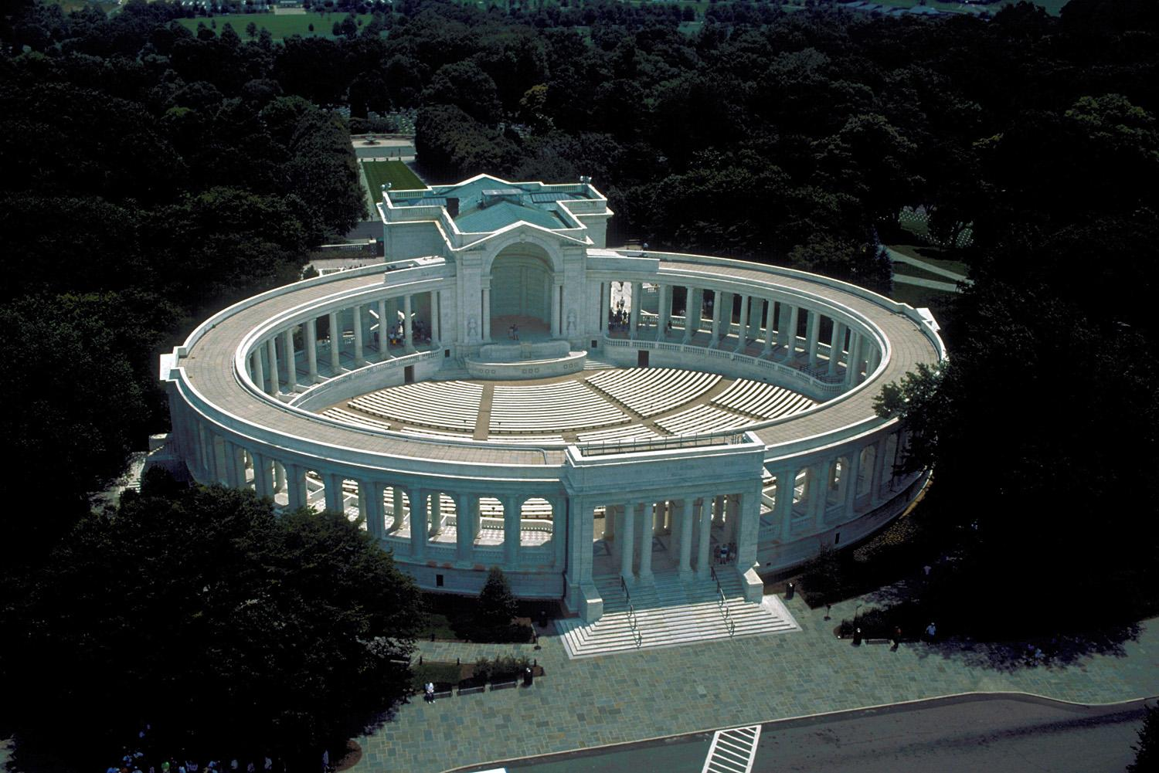
Insert photo
This image is a work of a U.S. Army Corps of Engineers employee, taken as part of that person's official duties.

Slide 22
Uncopyrightable
Idea, procedure, process, system, method of operation,
concept, principle, or discovery;
Words and short phrases such as names, titles, and slogans;
Familiar symbols or designs;
Mere variations of typographic ornamentation, lettering or coloring;
Mere listing of ingredients or contents;
Works created by US government;
Some useful articles, such as fashion, furniture, food, clothing, whitepages, buildings finished before 1990;
Merger, or scènes à faire
Notes:
scènes à faire: elements that are standard or indispensable

Slide 23
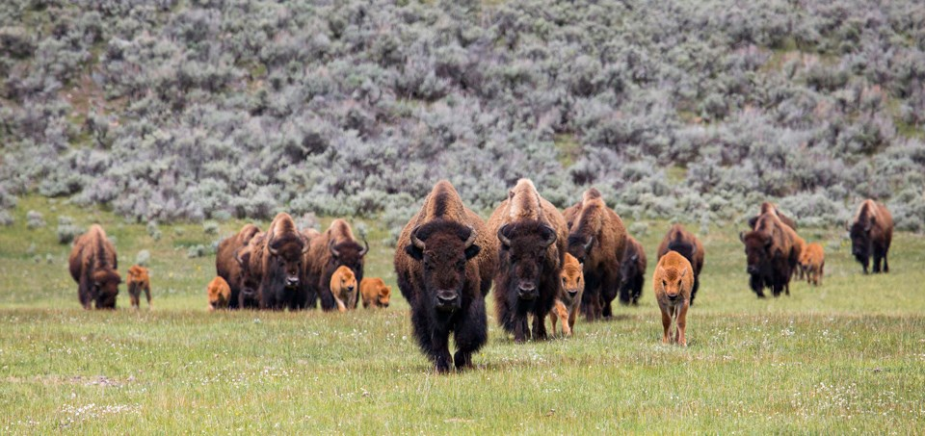
Insert photo
Photo Credit: National Park Service
Bison population in Yellowstone NP is growing 10 times faster than worldwide human population growth

Slide 24
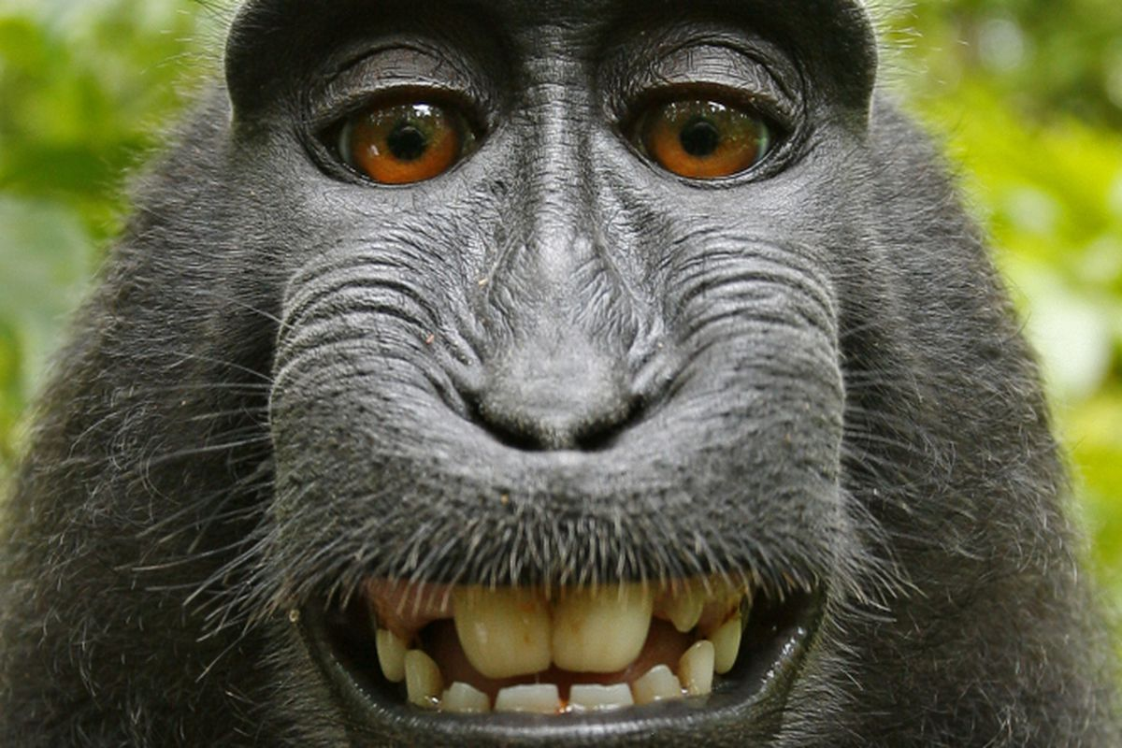
Insert photo

Slide 25
Authorship
The creator
Work made for hire
Prepared by Employee, or
Nine types of works with a signed contract...

Slide 26
Work Made for Hire - second possibility:
the work is specially ordered or commissioned as:
compilation
contribution to a collective work
part of a motion picture or other audiovisual work
translation
supplementary work
instructional text
test
answer material for a test
atlas

Slide 27
Work Made for Hire
Who holds copyright?
Wednesday, 10am. An accountant, employed by NPS, was flying home from a work trip. His colleague, a photographer (also employed by NPS), messaged the accountant to take some aerial photos of the NP he was flying over. The accountant emailed the photos to the photographer as soon as he was back to the office that afternoon.

Slide 28
Work Made for Hire
Who holds copyright?
The same story. This time, the photographer and the accountant agreed (& signed) in writing that the photos were “works made for hire.” The photographer printed the photos as postcards and sold them online. The accountant’s name was not mentioned as the author of the photos.

Slide 29
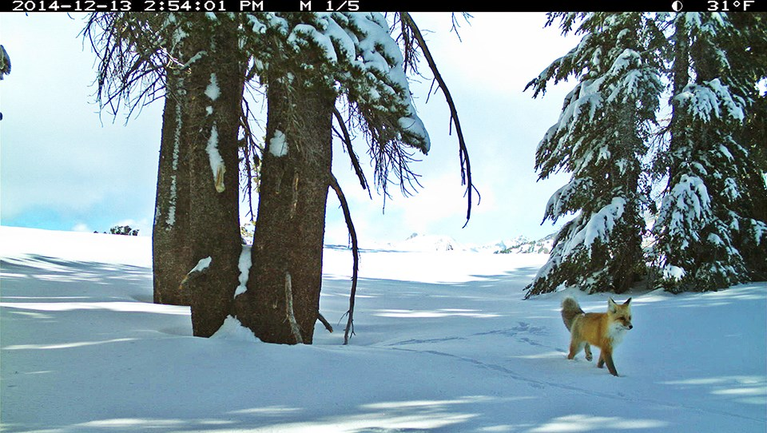

Slide 30
Duration of Copyright Protection
The relevant laws...
1909 Act
Relevant until 2072
1976 Act
Relevant since 1978

Slide 31
Duration of Copyright Protection
1790 Act: 14+14; 1831 extension: 28+14
1909 Act: 28+28
1976 extension: 28+47
1998 extension: 28+67 (~1977)
1992: auto renewal (1965~ )
1976 Act: Life+50
1988: notice
Sonny Bono Act: Life+70
Notes:
The length of your copyright depends on when the work was created, published, and/or registered. Duration also depends on whether the work was created by an individual, more than one individual, or as employee or at the direction of another person or company. For works created by individual authors on or after January 1, 1978, copyright protection begins at the moment of creation and lasts for a period of 70 years after the author's death. In the case of "a joint work" (prepared by two or more authors) the term lasts for 70 years after the last surviving author's death. For works made for hire, and for anonymous and pseudonymous works, copyright protection generally lasts for 95 years from publication or 120 years from creation, whichever is shorter.
For works created before January 1, 1978 (protected under the 1909 Copyright Act), the duration rules are quite different (and much more complex). Duration depends on a number of factors, including whether the work was "published" and whether or not the copyright was renewed. In general, under the 1909 Copyright Act, copyright protection begins with first publication of the work and lasts for a period of 28 years, renewable for an additional term of 28 years, for a total term of protection of 56 years. In 1976, Congress extended the renewal term to 47 years, increasing the total possible term of protection to 75 years. In 1998, Congress again extended the renewal term by an additional 20 years, for total possible term of protection of 95 years from publication.
For works created but not published or registered by January 1, 1978, copyright lasts for a period of 70 years after the author's death (or at least through December 31, 2002). For works published on or before December 31, 2002, the term of copyright lasts through December 31, 2047.

Slide 32
Public Domain
Unpublished works, author died before 1948
Works published before 1923
Works published before 1989 w/o correct formalities
Works dedicated to the public domain

Slide 33
CC0

Slide 34
Exceptions and Limitations
Fair use
Libraries
First sale
Teaching
Reproduction for people with disabilities
& other exceptions as listed in 17 U.S.C. § 107~§ 122

Slide 35
Fair Use
Purpose of the use (Transformative use)
Nature of the copyrighted work
Amount used
Effect on the market
Notes:
Transformative: use is completely new or unexpected

Slide 36
Fair Use
True or False?
Educational uses are always fair use

Slide 37
Fair Use
True or False?
It is fair use posting one chapter from a 20 chapter book

Slide 38
Pretty Woman, walking down the street,
Pretty Woman, the kind I like to meet,
Pretty Woman, I don't believe you,
you're not the truth,
No one could look as good as you
Mercy
Pretty Woman, won't you pardon me,
Pretty Woman, I couldn't help but see,
Pretty Woman, that you look lovely as can be
Are you lonely just like me?
Pretty Woman, stop a while,
Pretty Woman, talk a while,
Pretty Woman give your smile to me
Pretty Woman, yeah, yeah, yeah
Pretty Woman, look my way,
Pretty Woman, say you'll stay with me
'Cause I need you, I'll treat you right
Come to me baby, Be mine tonight
Pretty Woman, don't walk on by,
Pretty Woman, don't make me cry,
Pretty Woman, don't walk away,
Hey, O. K.
If that's the way it must be, O. K.
I guess I'll go on home, it's late
There'll be tomorrow night, but wait!
What do I see
Is she walking back to me?
Yeah, she's walking back to me!
Oh, Pretty Woman.

Slide 39
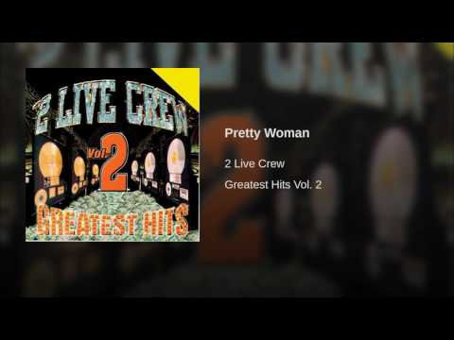
Pretty woman walkin' down the street
Pretty woman girl you look so sweet
Pretty woman you bring me down to that knee
Pretty woman you make me wanna beg please
Oh, pretty woman
Big hairy woman you need to shave that stuff
Big hairy woman you know I bet it's tough
Big hairy woman all that hair it ain't legit
'Cause you look like 'Cousin It'
Big hairy woman
Bald headed woman girl your hair won't grow
Bald headed woman you got a teeny weeny afro
Bald headed woman you know your hair could look nice
Bald headed woman first you got to roll it with rice
Bald headed woman here, let me get this hunk of biz for ya
Ya know what I'm saying you look better than rice a roni
Oh bald headed woman
Big hairy woman come on in
And don't forget your bald headed friend
Hey pretty woman let the boys
Jump in
Two timin' woman girl you know you ain't right
Two timin' woman you's out with my boy last night
Two timin' woman that takes a load off my mind
Two timin' woman now I know the baby ain't mine
Oh, two timin' woman
Oh pretty woman

Slide 40
Permission
You hold copyright
Public licenses
Licenses secured by U-M
Ask for permission

Slide 41
Permission
True or False?
You go to Arlington Amphitheater and take a photo of the architecture. You can use it however you’d like.

Slide 42
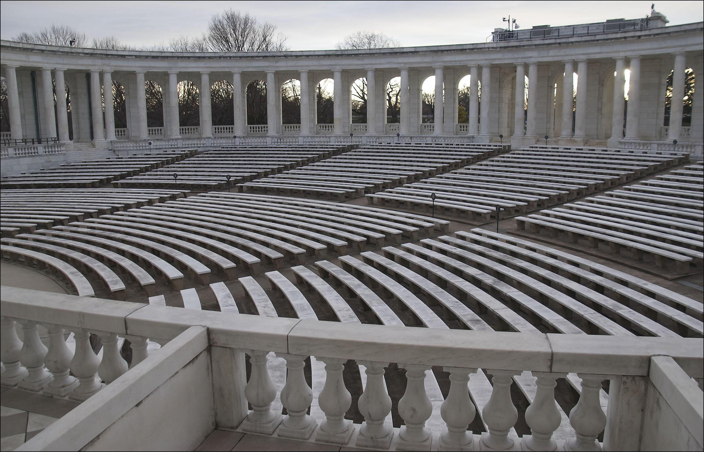
Ron Cogswell
CC BY

Slide 43
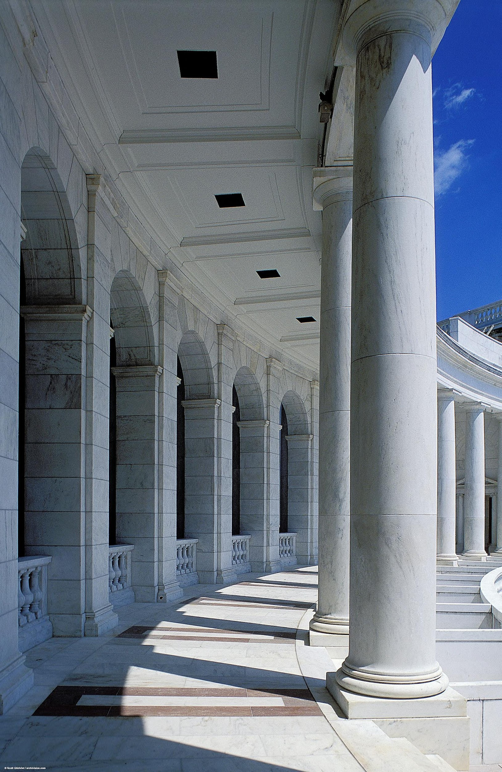
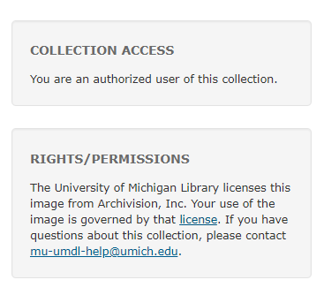
Site License

Slide 44
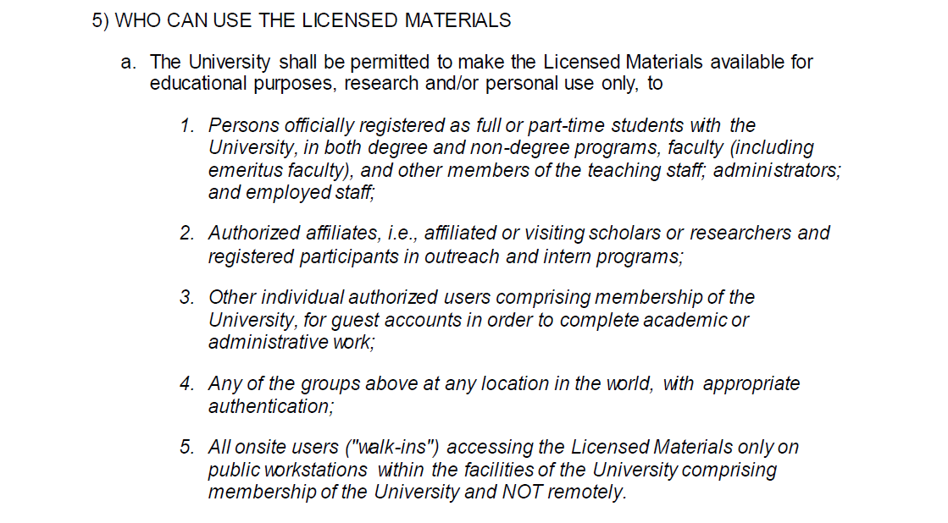

Slide 45
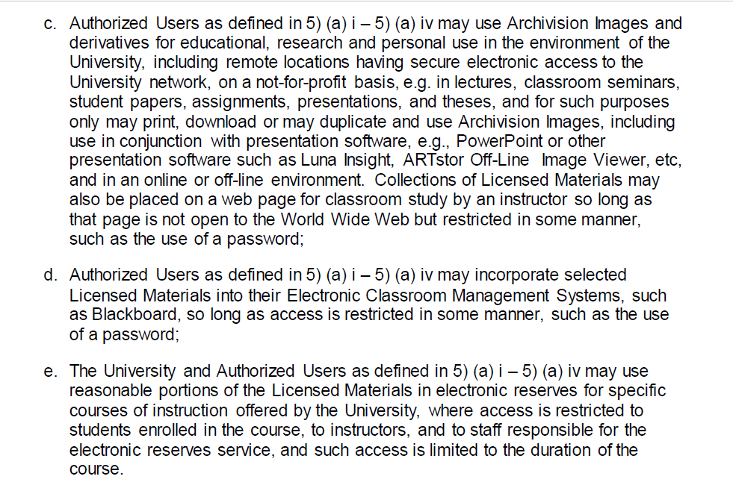

Slide 46
Permission
True or False?
You go to the same amphitheater and take a photo of the architecture. I can use your photo.

Slide 47
Review
Copyright is a bundle of exclusive rights
Scope of copyright
Original + Fixed
Term: Life + 70
How to use copyrighted works
User’s rights
Permission

Slide 48
Thank you
UMLIB.US/COPYRIGHT2018

