Slide 1
Copyright &
Your Dissertation
Raven Lanier, Copyright Specialist
University of Michigan Library Copyright Office
Notes:
Created in Fall 2019 for SW 800.

Slide 2
Agenda
Copyright Basics
Using Other’s Work
Public Domain
Fair Use
Permissions and Creative Commons Licenses
Copyright Infringement vs. Plagiarism
Copyright & Publishing

Slide 3
Basics
No protection for ideas
Expressions are protected, not the ideas themselves
Things common to a style (viking ships in a viking movie) aren’t copyrightable
Procedures, processes, systems, concepts, and facts aren’t protected
If a work is not protected by copyright, it is free to use
To be protected by copyright, a work must be:
Original (independently created with some spark of creativity)
Fixed
Notes:
One of the most important things to remember when thinking about copyright is that it isn’t meant to protect everything. For instance, copyright doesn’t protect ideas, just the way those ideas are expressed. If you write a book about two young people from different backgrounds falling in love despite their warring families, you can’t keep other people from writing a book, movie, or play about the same idea. But you could keep people from adapting your book into a screenplay, writing a sequel, or putting chapters of it up on the internet. Copyright also doesn’t protect things that are common to a sort of genre, like viking helmets and ships in a viking movie or standing out in the rain as you confess your love in a romcom. Neither does it protect procedures, processes, systems, concepts, or facts. So things like mathematics, laws of nature, and weights and measurements aren’t copyrightable, and neither are recipes or ingredients lists.
So what is protected by copyright? Basically, any original, creative type of expression that’s fixed. This includes the things you’d typically think of, like literary works, videos, all kinds of art, and music, but it also includes things like software and architecture. The bar for originality and creativity is very low. An alphabetical list of names and phone numbers are not creative enough to be covered by copyright, but the email you sent to your coworker today is. We create things every day that copyright protects, from texts to photos to videos.

Slide 4
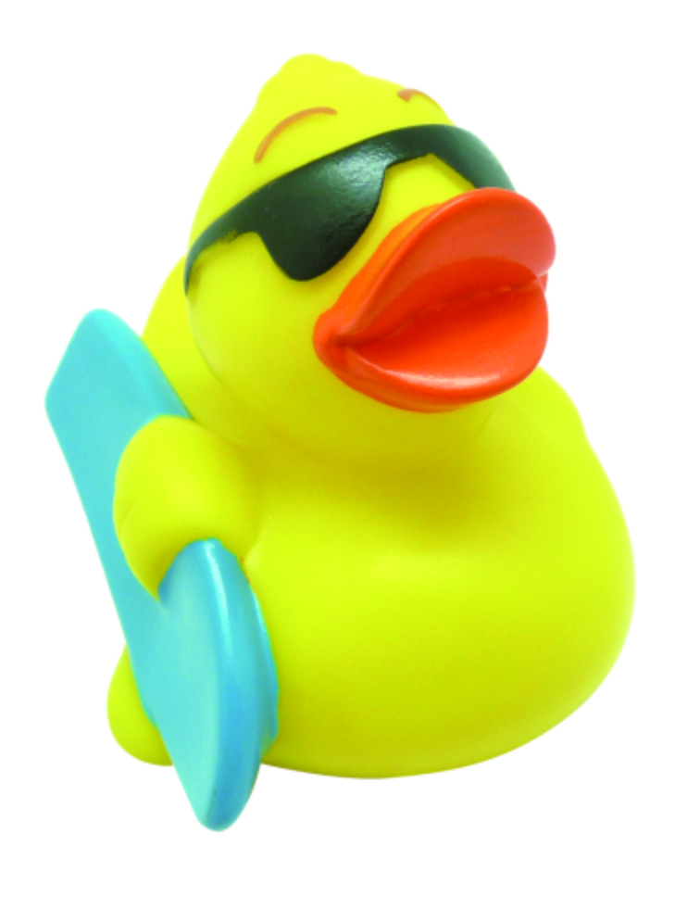
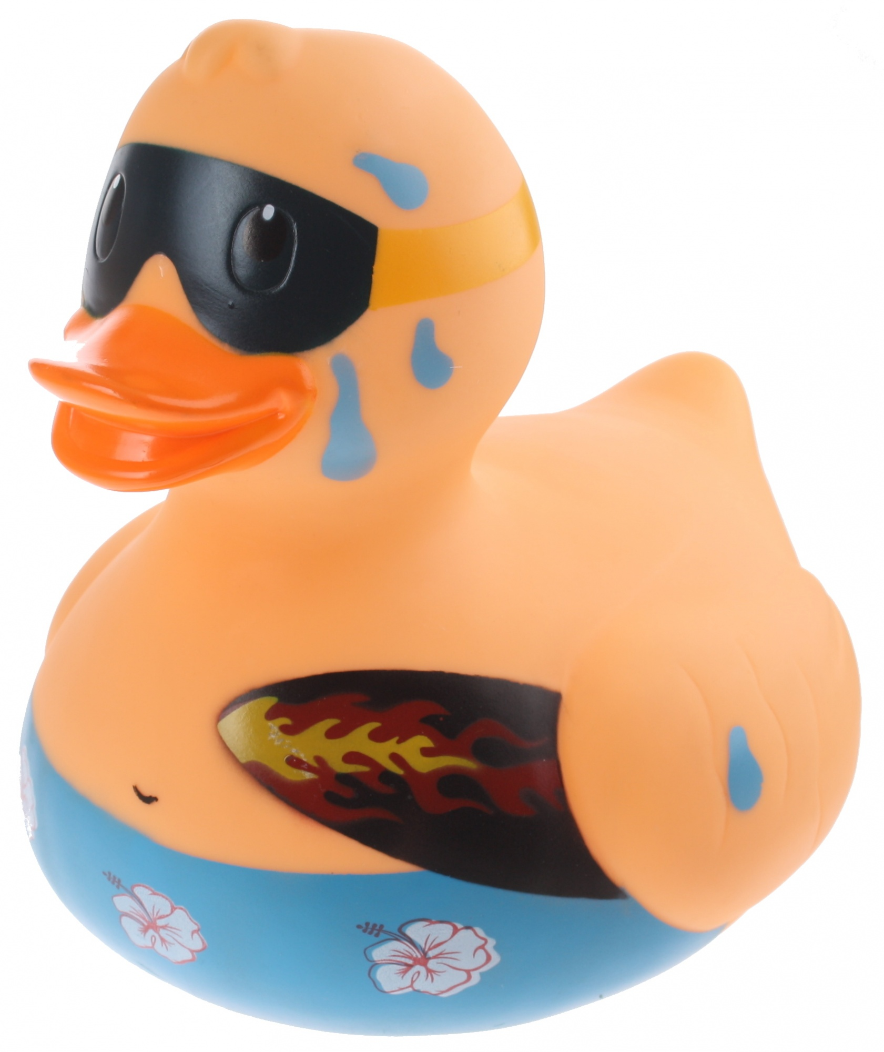
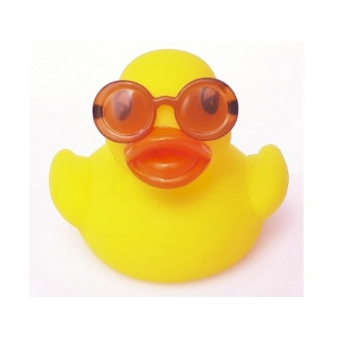
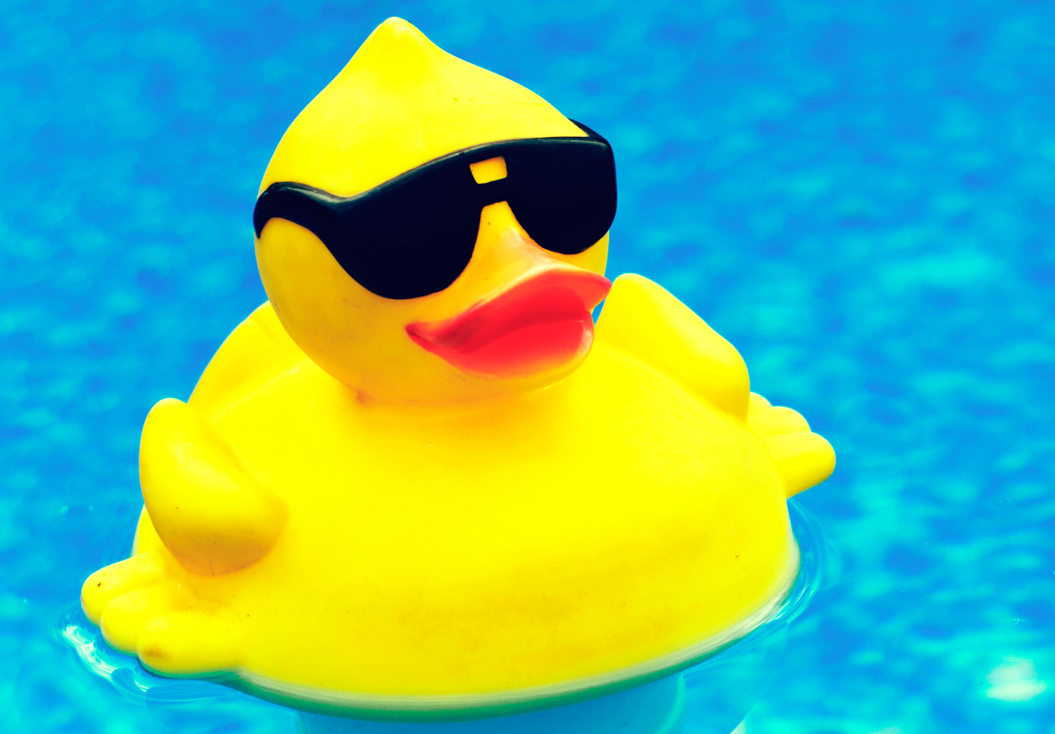
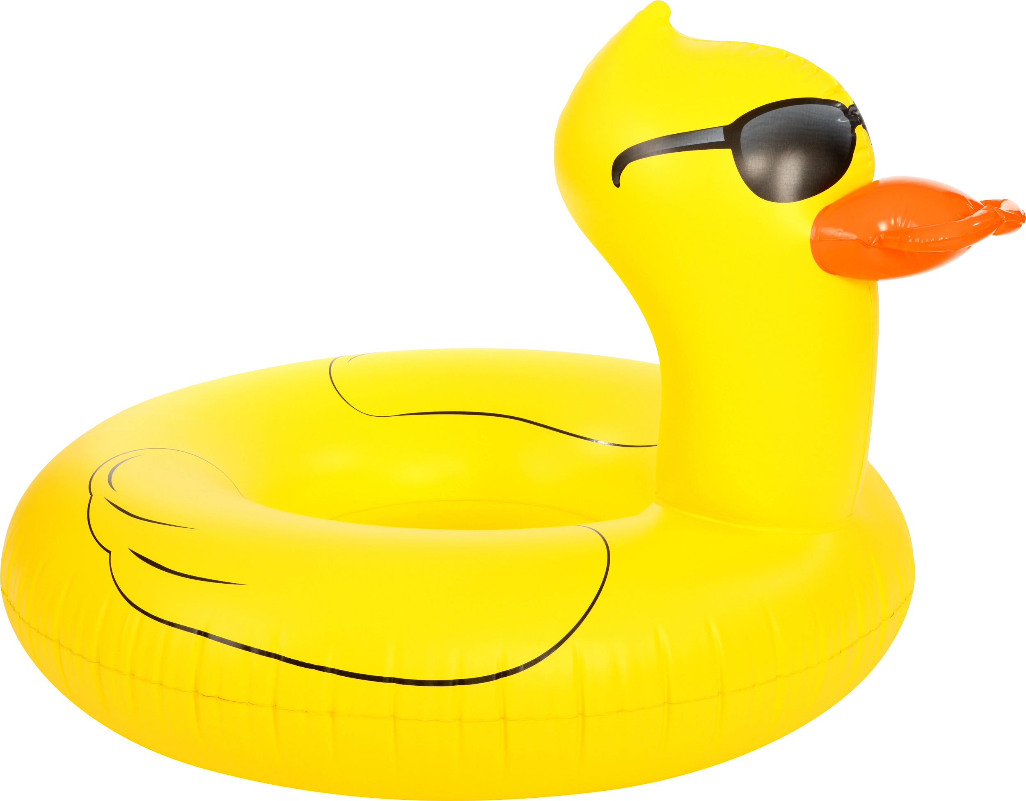
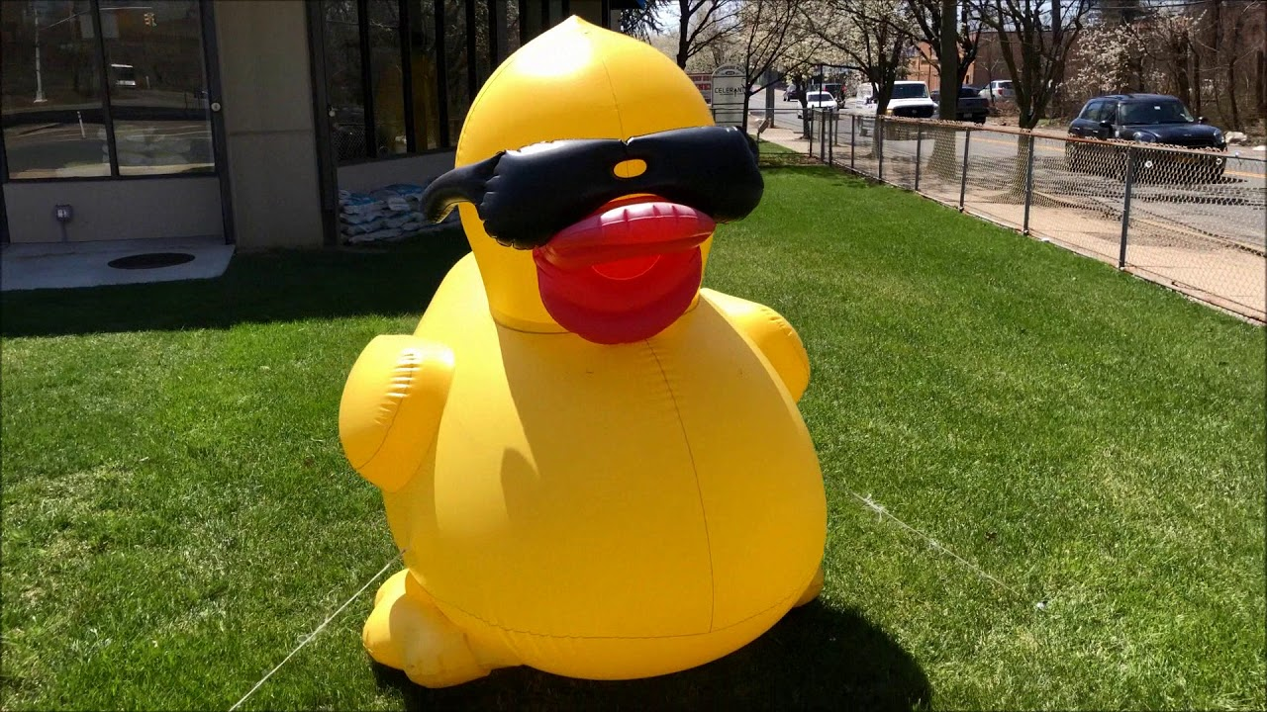

Slide 5
Basics
Protection attaches as soon as the work is created
Can register with the US Copyright Office to get legal benefits
Online at copyright.gov for a small fee
Gives copyright holder certain exclusive rights:
Make copies
Make derivative works
Distribute the work
Publicly perform/display the work
Protection lasts for life of the author plus 70 years
Notes:
So we now know that we create works every single day (maybe even every hour!) that can be covered by copyright. How do you get copyright protection for your work? The good news is that you don’t have to do anything. Copyright protection applies automatically; you get it as soon as you create a copyrightable work. If you want to make it official and get some other legal benefits (like being able to sue if someone if they infringe on your copyright), you can register with the United States Copyright Office at copyright.gov.
As the copyright holder, you get a set of rights that give you a near monopoly over the work you created. Copyright law has some exceptions and rights given to users (one of them is fair use, which we’ll cover later), but basically lets you be the only person who can make copies, derivative works, distribute the work, or publically perform the work. If you write a song, you can keep people from being able to publicly perform it without paying you. You can also prevent people from making copies of the lyrics or music, distributing them to the public, or making a video based on your song. As the song’s copyright holder, you have control over who does what with your work. These rights will last for the length of your life (since you’re the creator) plus seventy years after. So if an author of a book died in 2010, the book would be protected until 2080, even if the author transferred the copyright in her book to a publisher or a family member.

Slide 6
Using Others’ Content
Copyright considerations when using third party content:
Is the work not copyrightable or in the public domain?
Is your use a fair use?
Do you have permission or a license to use the work?
Watch out for constrictive terms of service that do not allow reuse
Contract law, not copyright law
May also cover your previously published works
Notes:
When including third party content in your dissertation, you have to think about copyright law. Copyright protects creative works as soon as they are fixed in a tangible medium. The bar for creativity is very low; a large majority of works have the creativity needed to qualify for copyright protection. Copyright gives creators control over

Slide 7
Public Domain
Works that are in the public domain no longer have copyright protection
Copyright term of the work has expired
Copyright holder released the work to the public domain
Free to use in any way without having to give attribution or worry about copyright restrictions
Works published in the US before 1924 are in the public domain
Gain new works on January 1
Consult Cornell’s Copyright Term and the Public Domain chart for other works
Works created by the US government are automatically in the public domain
Notes:
The public domain is filled with works whose authors have given up their copyright term or whose copyright term has run out; this means they don’t have any copyright restrictions at all. You are free to use a public domain work in any way you want-- edit it, add to it, sell it-- all without having to ask for permission, do a fair use analysis, or even attribute back to the original author.
All works that were published in the US before 1924 are now in the public domain, as well as all works created by the US government. Some other works that were published before 1989 could also be in the public domain because they didn’t comply with formalities that were required at the time (but were no longer required after 1989). If you’re interested in using a certain work that was published before 1989, you can use Cornell’s Copyright Term and the Public Domain chart (linked above) to help figure out if the work is in the public domain.
I realize that most of you aren’t really that interested in using worked that were published before 1924, but there are also a lot of modern works that have been donated to the public domain.

Slide 8
Fair Use
Fair use is a user’s right built into copyright law
Allows some otherwise infringing uses to be noninfringing
Don’t have to get permission from the copyright holder
Meant to encourage development and creativity
Allows people to build upon the works of others
Four Factors:
The purpose and character of the use, including whether the use is commercial or for nonprofit educational purposes
The nature of the copyrighted work
The amount and substantiality of the portion used
The effect of the use on the potential market for or value of the copyrighted work
Notes:
As we’ve seen, it’s pretty easy to infringe on someone else’s copyright. If there weren’t any users’ rights in copyright law, you would have to go to the copyright holder for every single use of their work that you wanted to make. Do you want to include quotes from a book in a news article? Make a parody of a well known song? Use a clip of a movie for a movie review? You’d need permission, or copyright law would keep you from doing all of these things.
Luckily, here in the US we have fair use, which allows us to make all of these uses, along with many others, without having to ask the copyright holder for permission every single time we want to use their work. Fair use is meant to encourage development and creativity by promoting certain favored uses including criticism, commentary, research, and teaching. Now, not every use is a fair use. If you think your use may be fair, you need to do an analysis that includes four factors.
The first factor is the purpose and character of the use, including whether or not the use is commercial or non profit and educational. For example, if you are using material in a classroom or for teaching, that would be an educational purpose and would weigh in favor of fair use. If your use was instead commercial in nature, like selling an image on t-shirts, it would weigh against fair use. This is also where you look at how transformative your use of the work is compared to the original work. Uses that give the original work a different purpose-- that transform it into something completely new with a different meaning and message-- are more likely to be a fair use. For example, taking someone else’s photograph and posting it on your own website simply for others to view it is not transformative, but displaying those photographs as thumbnails in an image search engine is.
The second factor is the nature of the copyrighted work: whether the work is factual or creative. If works are purely factual, they do not receive copyright protection. But for the works that are both factual and creative enough to be protectable, the copyright protection given to them is thinner than one given to a more creative work, and your use of that work is more likely to be fair under the second factor. The second factor also looks at whether a work is published or unpublished; if you use a work that’s unpublished, it’s less likely to be a fair use.
The third factor deals with both the quantity and the quality of the copyrighted work you use in your own. Taking a small portion of the copyrighted work will typically weigh more in favor of fair use than taking a larger portion or using the entire work. However, even using small portions of a work can weigh against fair use if the portion you’re taking is the most important part of the work. This factor is very context specific; the more transformative your use under the first factor, the more different it is from the original work, the more of the original work you can use. Some transformative uses use the entirety of the copyrighted work, and because of that transformativeness, this factor still weighs in favor of fair use. Again, it’s all about context.
The fourth factor is the effect your use has on the market or potential market for the original copyrighted work. If your use of the work would replace the original work in the market, it weighs heavily against fair use. An exception is made for critical commentary and parody; people no longer buying the original work because they’ve been convinced not to is much different than them buying your work instead because it is basically the same.

Slide 9
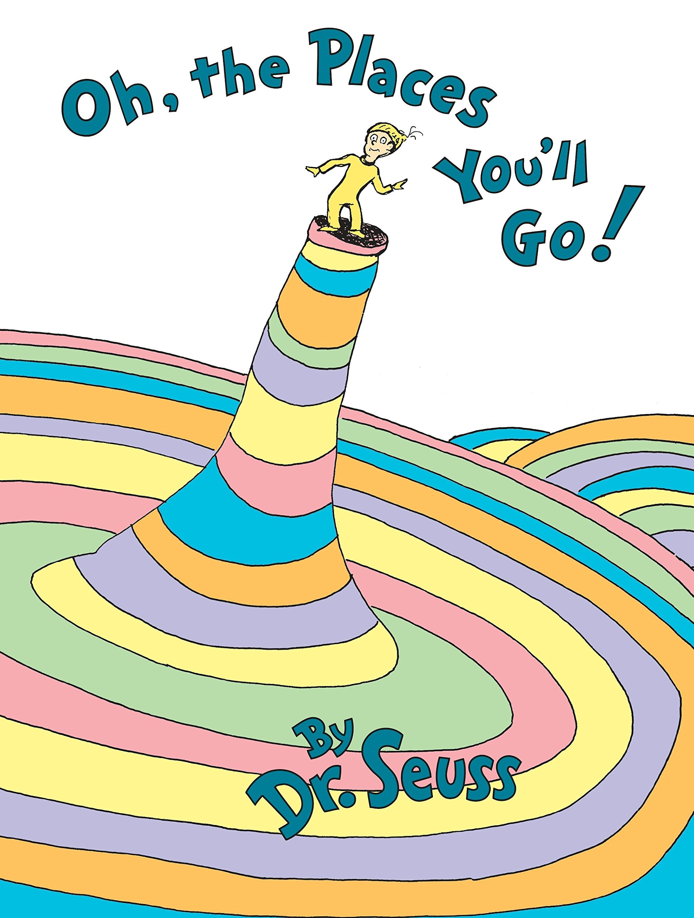
Notes:
Now that we’ve learned about the four factors, let’s think about how we would apply them. The Seuss estate is known for being very protective of its copyrights, and there have been several lawsuits involving different Dr. Seuss books. The most recent one involved a play on Oh, the Places You’ll Go! entitled Oh, the Places You’ll Boldly Go! As you can probably guess, Boldly is all about Star Trek.
Here you can see the cover for both books. As you look at the images, you can see that the look and feel is very similar. The art style and font are both very similar, and the arrangement of characters and other elements mimics the Dr. Seuss books.

Slide 10
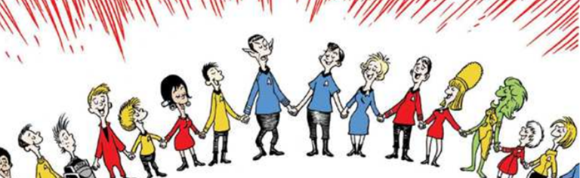
Notes:
Here’s another example of the two works side by side. At the top you might recognize How the Grinch Stole Christmas. At the bottom is a scene from Boldly.

Slide 11
Notes:
Here’s one last comparison of Boldly and Go. What do you think? Was Boldly’s use of Dr. Seuss’s works a fair use, or was it not fair? Take a moment to think about the four factors we just discussed.
How many of you think Boldly is a fair use?
How many of you think it is NOT a fair use?

Slide 12
Dr. Seuss Enterprises v. ComicMix
First factor: for fair use
Boldly! is not a parody, it’s a mashup, so the protection is slightly different
Very transformative, making it less important that the book was commercial
Second factor: slightly against fair use
Creative, but published extensively and for a long time
Third factor: for fair use
Used as much as was necessary to make the new transformative work
Fourth factor: neutral
Not a replacement, more for people who have read Go!
Dr. Seuss does license some versions and does collaborations
Verdict: fair use
Notes:
Let’s look at how the court thought about the factors.
The first factor weighed in favor of fair use. Although they didn’t find Boldly to be a parody (which means something more specific in copyright law than you might think), they did find it to be a mashup of Star Trek and Dr. Seuss. They also found that the book was incredibly transformative and gave the original Dr. Seuss books a different purpose and meaning, and this made it less important that the book was being sold commercially.
The second factor weighed slightly against fair use. Go is an incredibly creative work and is at the core of what copyright protects, but it has been published for a long time and a lot of copies have been sold.
The third factor weighed in favor of fair use. The court found that Boldly used as much from the original Dr. Seuss works as it needed to be a transformative mashup. It didn’t matter that Boldly could have used less of the Seuss works; it didn’t use too much, and that’s the important part.
The fourth factor was neutral and did not weigh for or against fair use. There was no evidence that Boldly would hurt the market for Go. In fact, it was likely that the only people who would be interested in Boldly would be people who had already read and were familiar with Go. But Dr. Seuss did license some different versions of Go and worked with others on collaborations. Overall, none of this was enough to sway the factor in one way or another.
So what was the verdict? Recently, the court found that Boldly was a fair use. Dr. Seuss has appealed, meaning this case isn’t quite over yet, so if you’re interested, you may want to watch the news about this one.

Slide 13
Permission
Be certain and clear about what you’re asking for
Contact the copyright holder
Originally the author, but could have been transferred
Copyrights are typically transferred to publishers
Start early!
Notes:
Permission is only necessary under copyright law if the work is copyrightable, not in the public domain, and not a fair use. There are reasons you may want to ask for permission to use the work even if permission is not necessary. For example, you may need to maintain a relationship with the copyright holder and know that that relationship could be upset if you make a fair use.
So how do you ask for permission? This can be a bit complicated, especially if you can’t find the copyright holder or they won’t respond to your emails. Here are three quick tips that should help you sort through how and who to ask if you ever need permission to use a work.
First, be certain about what you want and make sure you’re clear when you ask for it. Know up front how you want to use the work, how many people will see it, etc. This can help the copyright holder make a quicker decision about whether or not they want to give you permission and how much they want to charge for it.
Also, try to find and contact the copyright holder. This may be the author of the work, but it also may not be. Copyrights can and are commonly transferred to other people. For instance, a copyright in a journal article is typically transferred to the publisher when the work is published. If you wanted permission to use the journal article, you would need to contact the publisher, not the author. Similarly, copyrights can be transferred through will. If the author of the work is deceased, their spouse or children may now hold the copyright, and you would want to go to them for permission.
And finally, try to get your permission request to the copyright holder as soon as possible. Sometimes they can be slow about responding, so if you have a deadline, give them plenty of notice.
If you have more questions about how to get permission, we have a libguide on Obtaining Copyright Permission that covers how to ask permission for different types of works and a sample permissions request letter.

Slide 14
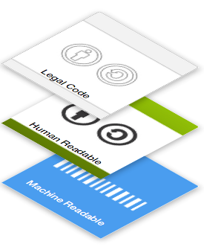
Creative Commons Licenses
Legal Code
Legally binding terms of the license
Upheld in court
Human Readable Deed
Clear, understandable version of the license
Easy for everyone to use
Machine Readable Code
Indexed by search engines and other sites
Makes works easy to find
Notes:
Sometimes copyright holders give blanket permissions through licenses like a Creative Commons license. Creative Commons created a set of licenses that are meant to bridge the gap between copyright holders and users. CC licenses give copyright holders the ability to pick how they would allow others to use their work, all while getting what many of them want the most: credit. And in return, users can share, edit, remix, and build upon the work, benefitting both society and the original copyright holder.
In order to work efficiently, CC licenses are made up of three layers: the legal code, the human readable deed, and the machine readable code. The legal code is the foundation of the license, and is the part of the license that is binding and can be upheld in court. The second layer is the human readable code. Creative Commons realizes legalese isn’t a language spoken by most, so it translated the language of its licenses into something that can be easily understood and used by the average person. The final layer, the machine readable code, allows search engines like Google to easily find and provide CC licensed works to people who are interested in using them. All three layers are crucial to ensuring the licenses success in connecting copyright holders and users.

Slide 15
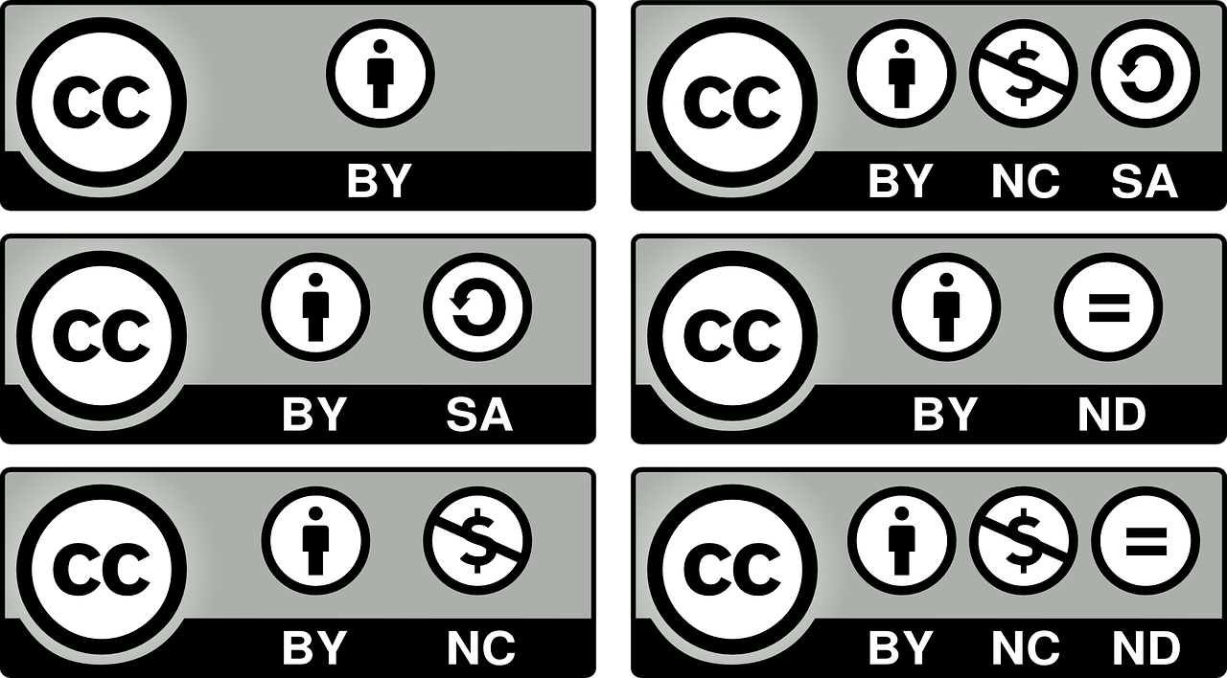
Types of CC Licenses
Notes:
CC licenses come in four different varieties: attribution (BY), share-a-like (SA), non-commercial (NC), and no derivatives (ND). All licenses include attribution, but the other options are up to the copyright holder. Copyright holders can pick and choose from combinations of the four varieties to let users know exactly how they’re okay with them using their works. For example, if a musician was okay with people remixing, reusing, and even reselling their music, but wanted to make sure those new works were under a CC license, the musician would license the song CC BY-SA. If the musician didn’t care what people did with the song, as long as they didn’t sell it, they would choose CC BY-NC. Creative Commons is flexible and adaptable to the needs of each copyright holder; no matter what you’re interested in, CC licenses can provide the right type of license to meet your needs.

Slide 16
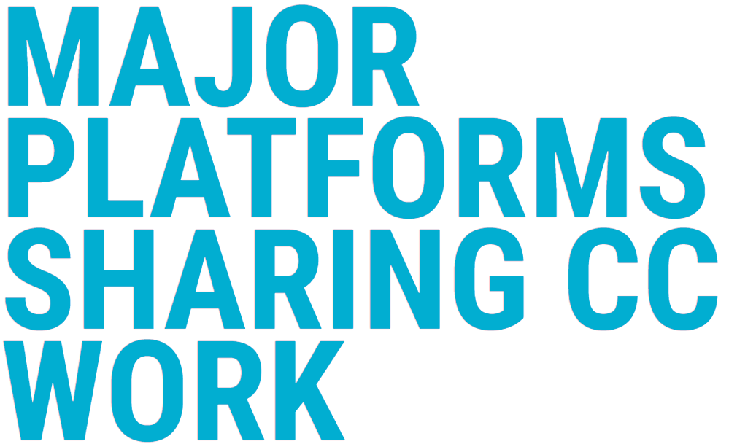
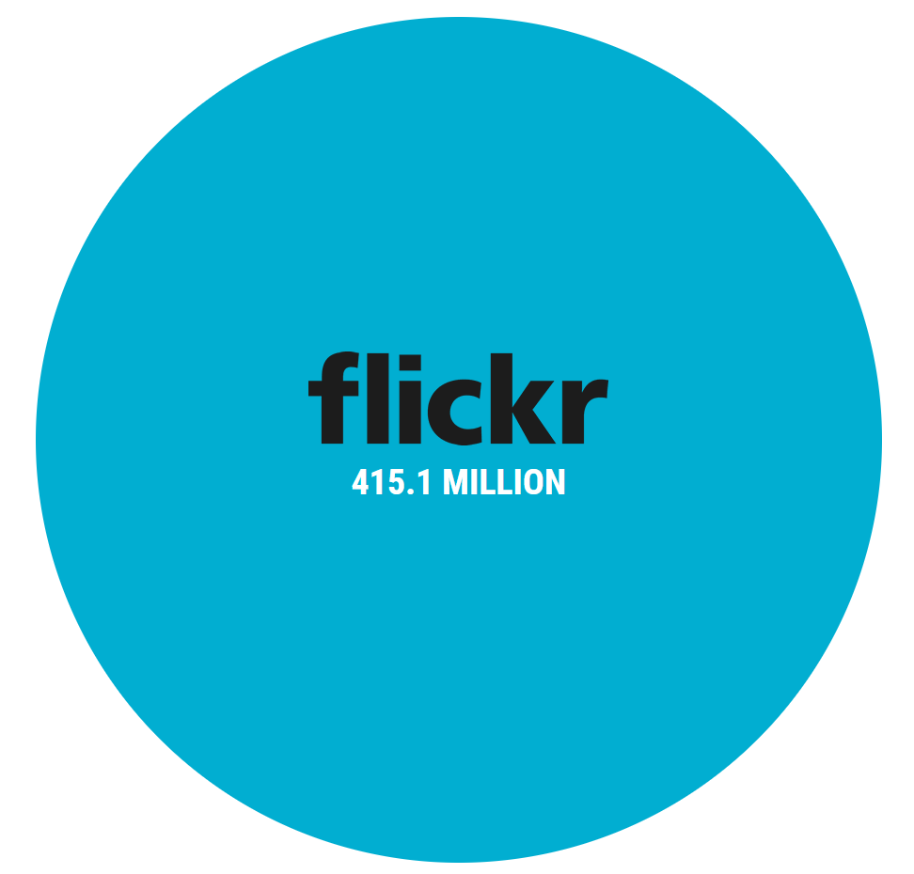
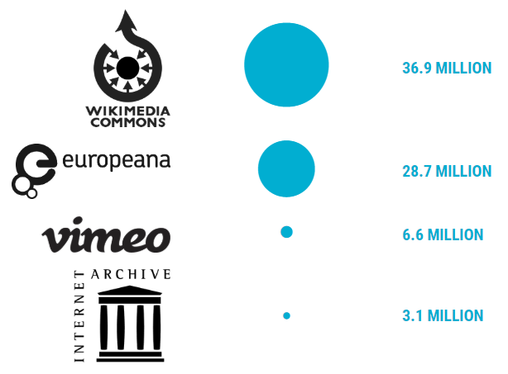
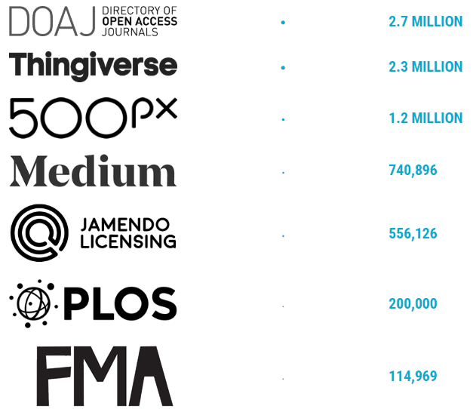

Slide 17
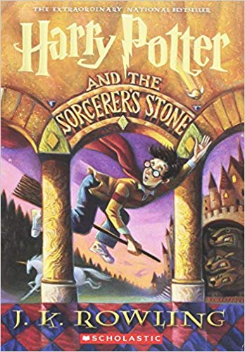
Copyright Infringement vs. Plagiarism
Plagiarism is passing someone else’s work off as your own
Copyright infringement can occur even when there’s no plagiarism
Ethical issue v. legal issue
Notes:
Harry Potter example: Putting a full Harry Potter novel online and saying that you wrote it is plagiarism AND copyright infringement. But even if you put the full novel online for anyone to view and say it’s by JK Rowling, you’re infringing her copyright.
At the same time, if you uploaded an entire public domain novel, you wouldn’t be infringing anyone’s copyright. But if you claimed you wrote the novel, you would be plagiarizing the author.
While plagiarism is a serious and potentially career ending issue, it’s not a legal issue.

Slide 18
Copyright & Publishing
Most publishing contracts transfer copyright to the publisher
Can negotiate for the right to:
Use your work in teaching, conference presentations, etc.
Use your work in future publications
Deposit in institutional repository (Deep Blue)
Open Access (OA)
Movement to make scholarship freely available, accessible, and easy to share
Often accomplished using a Creative Commons License
Can require payment upfront (Author Processing Charge)

Slide 19
Keep a copy of your publishing contract.

Slide 20
Questions?
U-M Library Copyright Office Guides
Copyright for Dissertations
Copyright Basics
Obtaining Copyright Permission
Creative Commons
Contact us at:
copyright@umich.edu
rnlanier@umich.edu

