Slide 1
What Copyright Covers
October 5, 2016
Ana Enriquez

Slide 2
Fall Copyright Workshops
Copyright Basics
Introduction to Copyright, September 20
What Copyright Covers, October 5
Finding the Public Domain, October 11
Fair Use Cases, October 21
Copyright Licenses, October 26
Topics in Copyright
Copyright and Your Dissertation, October 20
Publishing Contracts, November 2
Copyright for Online Exhibits & Collections, November 14
Copyright and Canvas, November 17
Locations: Hatcher Gallery Lab OR online via BlueJeans
Details: Visit umlib.us/ttcsessions or email Ana (anaenriq@umich.edu)

Slide 3
Questions to consider
Is the work protected by copyright?
It is the sort of thing copyright protects?
Is it currently protected?
Would your use violate one of the exclusive rights given to copyright holders?
Who holds the copyright? Have they already made any licenses that would permit your use?
Do any of the exceptions to copyright, such as fair use, apply?

Slide 4
The plan
What copyright covers (25 minutes)
Modicum of creativity
Independent creation
Fixation in a tangible medium
Idea/expression distinction
Merger
Scènes à faire
Questions? (5 minutes)
Hypotheticals (15 minutes)
Wrap up (15 minutes)
Please interrupt with questions!

Slide 5
Copyright
It aims “[t]o Promote the Progress of Science and useful Arts”
It gives authors certain rights in their works, and it limits the author’s rights by recognizing rights for users.

Slide 6
17 U.S.C. §102(a)
(a) Copyright protection subsists, in accordance with this title, in original works of authorship fixed in any tangible medium of expression, now known or later developed, from which they can be perceived, reproduced, or otherwise communicated, either directly or with the aid of a machine or device. Works of authorship include the following categories:
(1) literary works;
(2) musical works, including any accompanying words;
(3) dramatic works, including any accompanying music;
(4) pantomimes and choreographic works;
(5) pictorial, graphic, and sculptural works;
(6) motion pictures and other audiovisual works;
(7) sound recordings; and
(8) architectural works.

Slide 7
17 U.S.C. §102(b)
(b) In no case does copyright protection for an original work of authorship extend to any idea, procedure, process, system, method of operation, concept, principle, or discovery, regardless of the form in which it is described, explained, illustrated, or embodied in such work.

Slide 8
Copyright covers works of authorship that are:
Original AND
Fixed in a tangible medium of expression

Slide 9
Originality
Two requirements:
modicum of creativity AND
independent creation

Slide 10
Modicum of creativity

Slide 11
Feist v. Rural Telephone Service, 499 U.S. 340 (1991)
“Facts, whether alone or as part of a compilation, are not original and therefore may not be copyrighted. A factual compilation is eligible for copyright if it features an original selection or arrangement of facts, but the copyright is limited to the particular selection or arrangement. In no event may copyright extend to the facts themselves.”

Slide 12
Compendium of U.S. Copyright Office Practices, Third Edition, Section 312
“The Office may register a claim in a compilation containing the names of the author’s fifty favorite restaurants. While a restaurant or the name of a restaurant does not constitute copyrightable subject matter under Section 102(a) of the Act, a list of restaurant names may constitute a literary work, which is one of the congressionally established categories of authorship.”

Slide 13
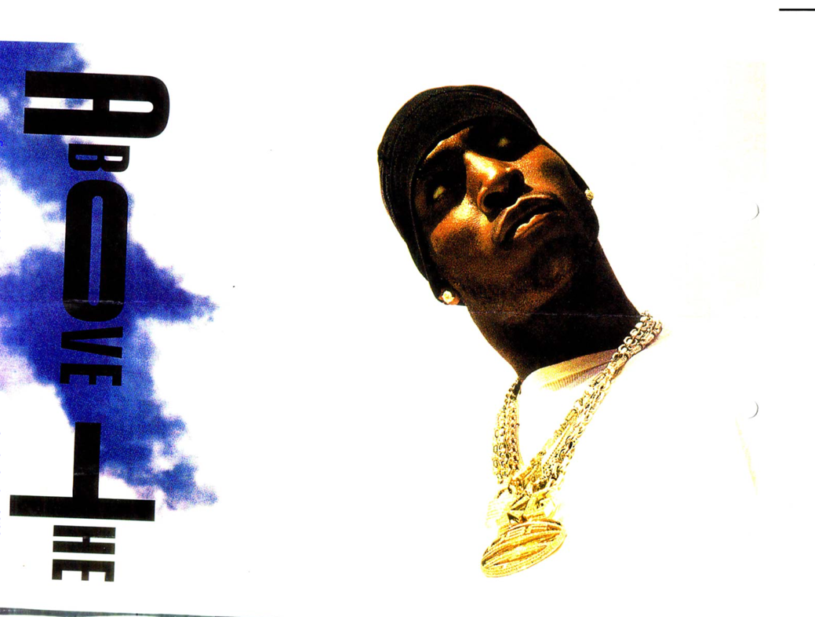
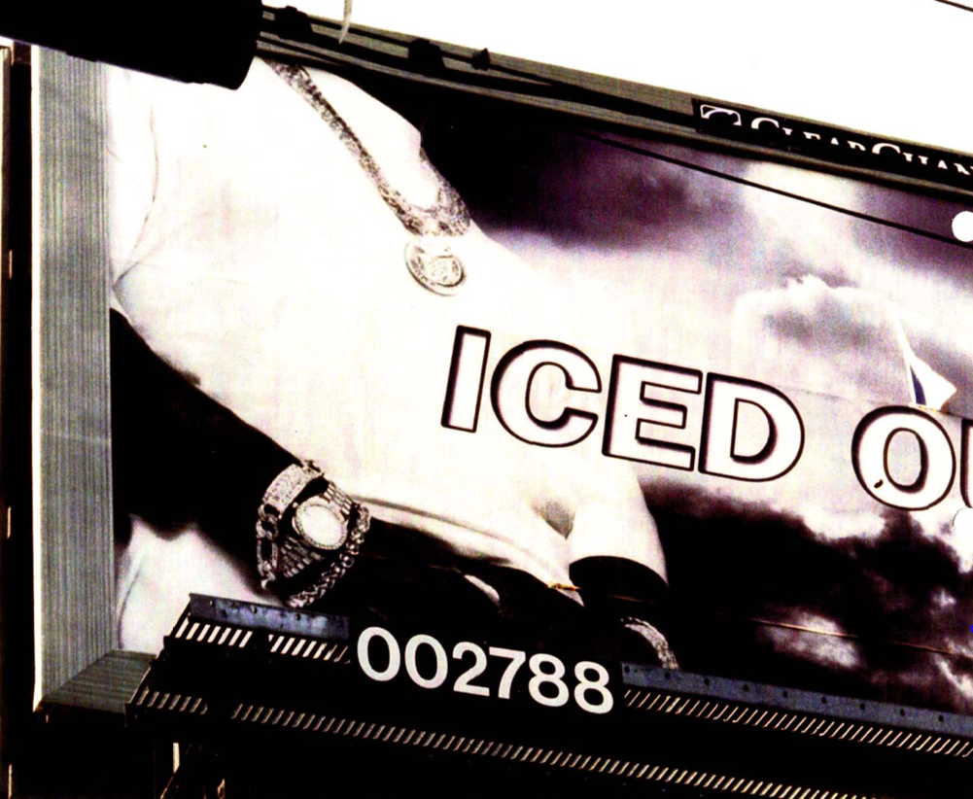
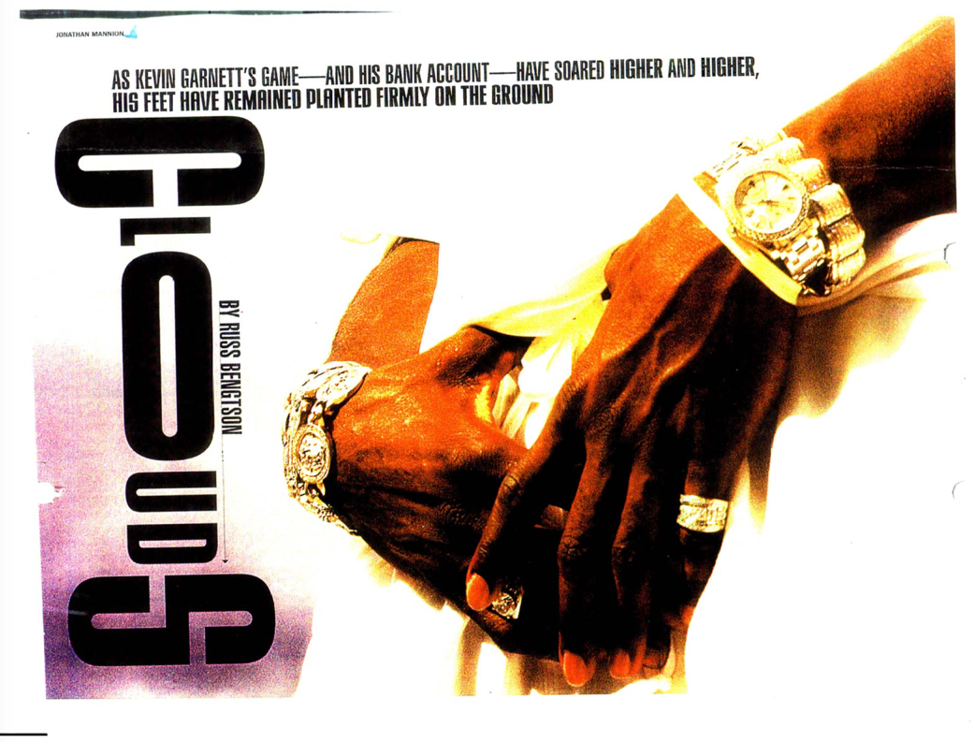
Mannion v. Coors Brewing Co, 377 F.Supp.2d 444 (S.D.N.Y. 2006)

Slide 14
Mannion v. Coors Brewing Co, 377 F.Supp.2d 444 (S.D.N.Y. 2006)
Protectable Elements of Photographs:
Rendition: “angle of shot, light and shade, exposure, effects achieved by means of filters, developing techniques etc. . . . copyright protects not what is depicted, but rather how it is depicted.”
Timing: “A modern work strikingly original in timing might be Catch of the Day, by noted wildlife photographer Thomas Mangelsen, which depicts a salmon that appears to be jumping into the gaping mouth of a brown bear at Brooks Falls in Katmai National Park, Alaska. . . . Copyright based on originality in timing is limited by the principle that copyright in a photograph ordinarily confers no rights over the subject matter.”
Creation of the subject: “An artist who arranges and then photographs a scene often will have the right to prevent others from duplicating that scene in a photograph or other medium.”

Slide 15
Independent creation

Slide 16
Compendium of U.S. Copyright Office Practices, Third Edition, Section 308
“The term ‘independent creation’ means that the author created the work without copying from other works.”
“If two authors created works that are similar or even identical, each work could be copyrightable, provided that the authors did not copy expression from each other.”

Slide 17
Fixation in a tangible medium

Slide 18
17 U.S.C. § 101
“A work is ‘fixed’ in a tangible medium of expression when its embodiment in a copy or phonorecord, by or under the authority of the author, is sufficiently permanent or stable to permit it to be perceived, reproduced, or otherwise communicated for a period of more than transitory duration. A work consisting of sounds, images, or both, that are being transmitted, is ‘fixed’ for purposes of this title if a fixation of the work is being made simultaneously with its transmission.”

Slide 19
Fixation
Fixed
Not fixed
Files on hard drive
Song on record
Snowman
Mandala
Jazz improvisation
Reflection in mirror

Slide 20
Anti-bootlegging
Separate cause of action under the Copyright Act

Slide 21
Idea/expression distinction

Slide 22
Copyright does not cover
any idea,
procedure,
process,
system,
method of operation,
concept,
principle,
or discovery,
regardless of the form in which it is described, explained, illustrated, or embodied in such work.
– 17 U.S.C. § 102(b)

Slide 23
Baker v. Selden, 101 U.S. 99 (1880)

Slide 24
Baker v. Selden, 101 U.S. 99 (1880)
“The copyright of a work on mathematical science cannot give to the author an exclusive right to the methods of operation which he propounds, or to the diagrams which he employs to explain them, so as to prevent an engineer from using them whenever occasion requires. The very object of publishing a book on science or the useful arts is to communicate to the world the useful knowledge which it contains. But this object would be frustrated if the knowledge could not be used without incurring the guilt of piracy of the book.”

Slide 25
Merger

Slide 26
Merger examples
Happy birthday, John!
Little Women
Artes, Scientia, Veritas
Marie Curie was born on November 7, 1867.

Slide 27
Scènes à faire

Slide 28
Nichols v. Universal Pictures, 45 F.2d 119 (1930).
“The only matter common to the two is a quarrel between a Jewish and an Irish father, the marriage of their children, the birth of grandchildren and a reconciliation . . . . [T]here is no monopoly in such a background.”

Slide 29
Questions?

Slide 30
Hypotheticals

